Slide 1
What is earth Science?
Ms maccormack
Fall 2017

Slide 2
Earth Science is….
A branch of science that deals with the physical make up of the Earth and its atmosphere.

Slide 3
Branches of Earth Science
There are 4 branches of Earth Science:
1. Astronomy
2. Geology
3. Meteorology
4. Oceanography

Slide 4
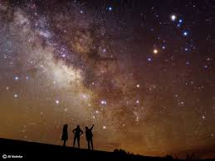
Astronomy
Studies the objects beyond Earth’s atmopshere

Slide 5
geology
Studies the solid parts of Earth and its interior

Slide 6
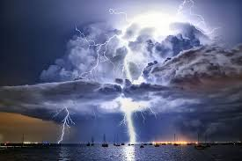
Meteorology
Studies the gases that surround the Earth and the interactions within them.

Slide 7
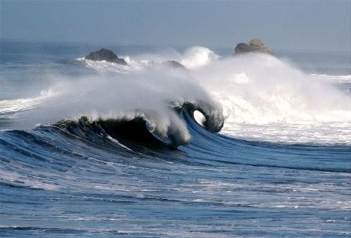
Oceanography
Study of Earth’s oceans. This includes their composition and movements.

Slide 8
Why earth Science?
https://www.youtube.com/watch?v=jxbIJH4fTYo

