Slide 1
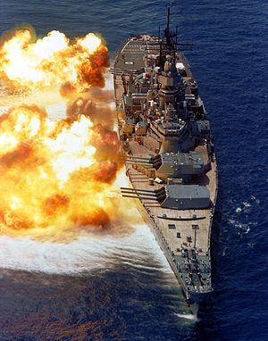
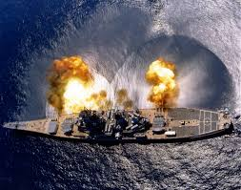
USS Iowa
The USS Iowa turret explosion occurred in the number two gun turret of the United States Navy battleship USS Iowa on 19 April 1989. The explosion in the center gun room killed 47 of the crewmen.

Slide 2
Location
The incident of the explosion of the ship Uss Iowa of the United States Navy happened in the Caribbean off the coast of Puerto Rico

Slide 3
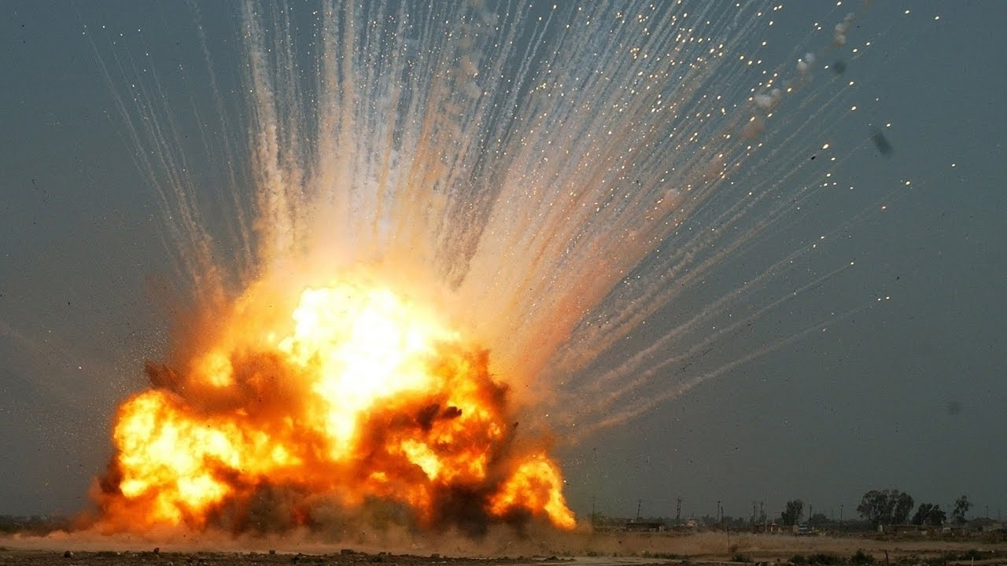
Initial Investigation
The first investigation into the explosion conducted by the U.S. Navy concluded that one of the gun turret crew members Clayton Hartwig who died in the explosion had deliberately caused it. They later found out Clayton caused the explosion because of a fight between him and Kendall Truitt who was his partner in a homosexual relationship.

Slide 4
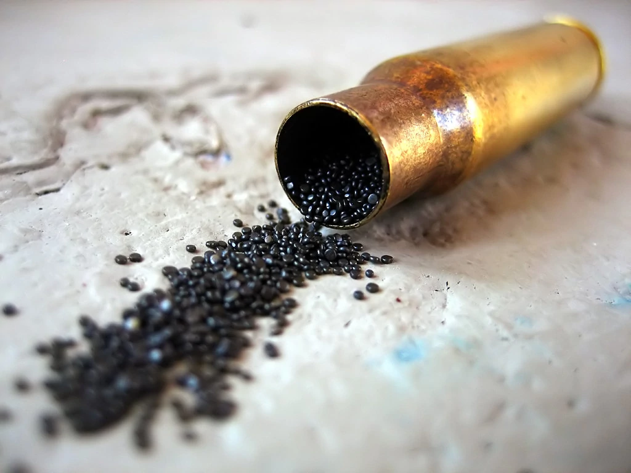
Second Investigation
Sandia determined that a significant overload of the powder bags into the gun had occurred as it was being loaded and that the overload could have caused the explosion. A subsequent test by the Navy of the scenario confirmed that an overload could have caused an explosion in the gun breech.

Slide 5
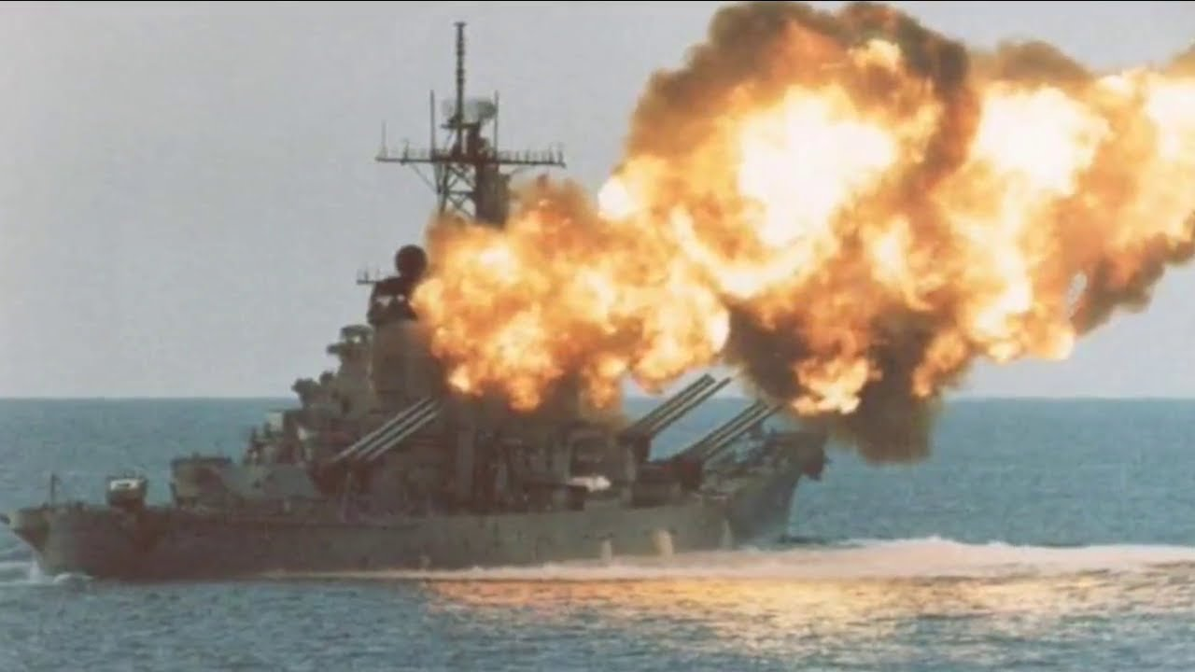
Third investigation
He stated that the Navy had uncovered no evidence to suggest that the gun had been operated improperly, nor had it established a plausible accidental cause for the explosion. Kelso stated, "The initial investigation was an honest attempt to weigh impartially all the evidence as it existed at the time. And indeed despite the Sandia theory and almost two years of subsequent testing, a substantial body of scientific and expert evidence continue to support the initial investigation finding that no plausible accidental cause can be established.

Slide 6
Timeline
~ Uss Iowa launched August 27,1942. Uss Iowa was the last lead ship of any class of battleship in the navy.
~ Uss Iowa Turret Explosion April 19,1981. The turner that exploded was the 16 inch naval gun. The explosion of the gun kills 47 people.
~ First Navy Investigation April 20 1981. The US Navy conducts their first investigation and comes to a conclusion that the explosion was caused by a crewman named Clayton Hartwig.
~ Sandia Investigation December 7 1989. After the outrage from the media and family's of the deceased about the investigation's findings there was a second investigation performed by a group of scientist who worked for GAO. They found that the explosion was caused by a overload of gunpowder bags into the rail gun. This conclusion meant the explosion was accidental .

Slide 7
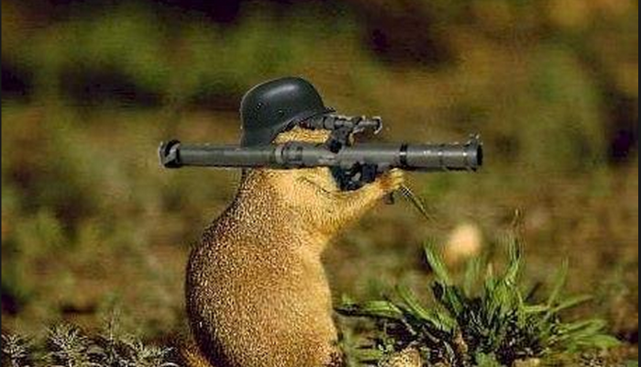
Timeline
~ Second Navy Investigation October 17 1991. The third and last investigation was done by the navy 10 years after the explosion of the Uss Iowa. In this investigation the navy came to the conclusion that there was no conclusion. They said they could not accurately recreate what had happened to the rail gun. This conclusion cleared the names of Kendall Truitt and the deceased Clayton Hartwig.

Slide 8
Question 1
Why was the case Uss Iowa so poorly handled? The Uss Iowa case was so poorly handled because of the lack of professionalism of the investigators and the improper handling of evidence. The case was not kept classified and there was many leaks to the media that occurred and this forced the investigators to speed up the investigation to come to a conclusion.

Slide 9
Question 2
Why were there multiple investigations done? There were many investigations because of media outrage about the initial conclusion of the investigation by United States Navy. The initial investigation concluded the explosion was caused by Clayton Hartwig who also died in the explosion. Due to media outrage GAO was hired to review the investigation. They found it was due to a overload of gunpowder in the gun. Then the navy conducted a third investigation concluding that there was no way to determine the cause of the explosion

Slide 10
Question 3
Was the relationship between Clayton Hartwig and Kendall Truitt real? The relationship between Clayton and Kendall was found out through an Investigation of Kendall by the NIS. In this Investigation they interviewed Kendall and his wife. They interviewed Kendall’s wife and in this interview that asked her about her sex life with Kendall and the acts of sex they engage in. This combined with continuous abusive interviewing tactics made Kendall admit to a homosexual relationship with Clayton. These tactics convinced people that Kendall’s confession was forced and false. Leading many people to believe that this relationship was falsified and used as a scapegoat for the US Navy.

Slide 11
Work Cited
"Battleship IOWA|Museum Ship of the Year." Battleship Iowa Museum Los Angeles. Web. 18 Apr. 2017.
"USS Iowa (BB-61) Battleship." Military Weapons. Web. 18 Apr. 2017.
The Veteran's Association of the USS IOWA (BB-61). Web. 18 Apr. 2017
USS Iowa (BB 61). Web. 18 Apr. 2017.

