Slide 1
The Crime Scene
Forensic Science
Ms. MacCormack
Spring 2017

Slide 2
Processing the Crime Scene
Physical Evidence – any and all objects that can establish that a crime has been committed or can provide a link between a crime and its victim or a crime and its perpetrator.
Can be anything from massive objects to microscopic traces.

Slide 3
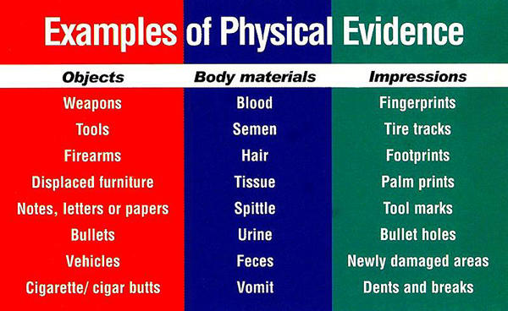

Slide 4
Secure and Isolate the Crime Scene
First officer arriving on the crime scene is responsible for taking steps to preserve and protect the area to the greatest extent possible.
Order of priorities
Obtain medical assistance for individuals in need and arrest the perpetrator.
Exclude all unauthorized personnel from the scene.
Isolate the area.

Slide 5
Secure and Isolate the Crime Scene
In securing the crime scene, the officer in charge of excluding ALL others must have the authority to exclude EVERYONE!!! This includes higher level police officials, members of the press and fellow police officers not involved in processing the site. This insures that all physical evidence will NOT be rendered valueless!!!!

Slide 6
Evaluation of the Area.
This is done once the area is secured.
Steps
Boundaries are determined
Establish perpetrators path of entry and exit
Document and photograph the obvious items of crime scene evidence
Initial walk through is completed to gain an overview of the situation and develop a strategy for the systematic examination and documentation of the entire crime scene

Slide 7
Record the Scene
This must be done right away
Methods used
Photography
Sketches
Notes

Slide 8
Photography
Must be unaltered
Objects must not be moved until they have been photographed from all necessary angles. This is assuming there are no injured parties involved.
If objects are removed, positions changed or items added, the photographs may not be admissible at a trial. If this does happen, it should be noted in the report. Evidence should NOT be reintroduced into the scene to take photographs!!!!

Slide 9
What should be included in photography of a crime scene?
The area in which the crime took place
All adjacent areas where important acts occurred immediately before or after the crime was committed.
Overview photographs of the entire scene and surrounding area
Points of entry and exit at various angles

Slide 10
Photographs of a crime that took place indoors
Entire room should be photographed to include each wall area.
Rooms adjacent to the actual crime must be done in a similar fashion as well.

Slide 11
Crime scenes involving a body
Photographs must be taken to show the body’s position and location relative to the entire scene.
Close-up photos showing injuries and weapons lying near the body should be included as well.
After the body is removed, the surface under the body should be photographed as well.

Slide 12
Photography of Physical Evidence
Photographed as they are discovered. Done so that they show their position and location relative to the entire scene.
Close-ups are taken as well.
If the size of an object is significant, a ruler or other measuring scale may be inserted near the object.

Slide 13
Sketches
These are made once the photographs are completed.
A rough sketch is completed.
Accurate depiction of the dimensions of the scene
Shows location of all objects that have a bearing on the case.

Slide 14
Rough Sketch Requirements
All objects should include distance measurements from two fixed points.
Each item in the sketch is designated with a letter or number and a legend is included on the sketch
A compass heading designating north should also be included.

Slide 15
Finished Sketch
Also called a scale sketch
Must reflect information shown in the rough sketch

Slide 16
Notes
Must be done constantly throughout the processing of the crime scene.
Include a detailed written description of the scene with the location of the items of physical evidence
Time item was discovered
By whom
Who packaged and marked the item
Disposition of the item after it was collected.

Slide 17
Search for Physical Evidence
Advisable to have one person in charge of supervising and coordinating the collection of evidence.
Areas searched must include all probable points of entry and exit used by the criminals
What to be searched for is determined by the circumstances of the individual crime.
Important to collect possible carriers of trace evidence in addition to the obvious items. (Clothing worn by those involved in the crime)

Slide 18
Search for Physical Evidence
Critical areas of the crime scene should be vacuumed and the sweepings submitted to the lab for analysis
Sweepings from different areas must be collected and package separately.
Portable vacuum equipped with a special filter is used

Slide 19
Items to be collected from victims body
Victims clothing
Fingernail scrapings
Head and pubic hairs
Blood (for DNA typing purposes)
Vaginal, anal and oral swabs (in sex-related crimes)
Recovered bullets from the body
Hand swabs from shooting victims (for gunshot residue analysis)

Slide 20
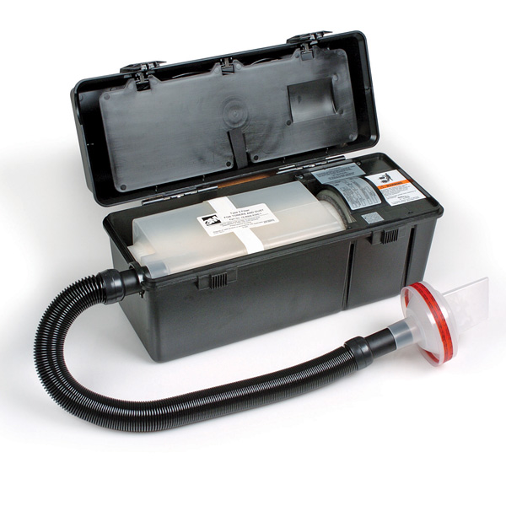

Slide 21
Collect and Package Physical Evidence
Must be packaged in a manner that prevents ANY changes from taking place between the time it is removed from the crime scene and the time it is received by the crime lab.
Causes of change
Contamination
Breakage
Evaporation
Accidental scratching or bending

Slide 22
Collect and Package Physical Evidence
All efforts must be given to keep the evidence in its original condition as found at the crime scene.
Evidence should be submitted to the crime lab intact.
Items need to packaged separately!!!
This helps to prevent damage through contact and prevents cross contamination.

Slide 23
The Well Prepared Evidence Collector
Forceps – picking up small objects
Plastic pill bottles with pressure lids – perfect for placing hairs, glass, fibers and other small or trace evidence.
Paper folded using the “druggist fold”

Slide 24
Packaging of Physical Evidence
Some samples need to be in air tight containers to prevent evaporation of pertroleum products from charred remains of a suspicious fire. New paint cans or tightly sealed jars are good for this situation.
All items of clothing are placed in special materials that prevent the growth of mold. These items are air-dried and placed individually in separate bags.

Slide 25
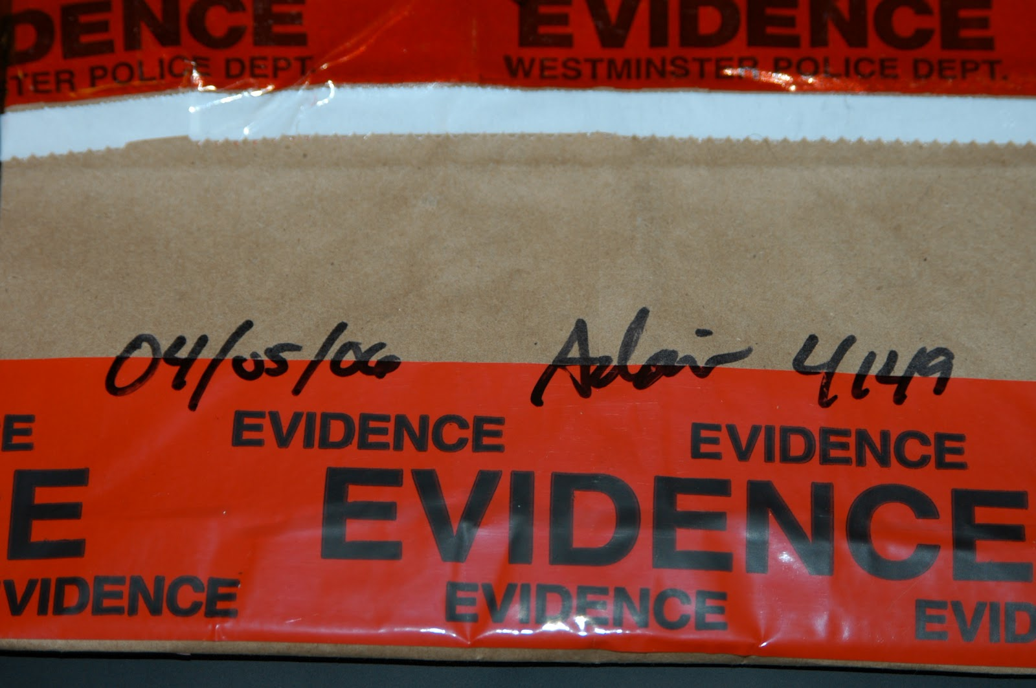
Chain of Custody
Individual who finds the evidence marks it for identification and bags the evidence.
This bag is then placed in an evidence bag that is labeled with the pertinent information.
This container is then sealed nd the collector’s signature is written across the sealed edge.

Slide 26
Chain of Custody
This container is then given to the next person responsible for its care.
This person takes it to the lab and signs it over to a technician.
The technician opens the package for examination at a place other than the sealed edge.
Upon completion of the examination, the technician repackages the evidence with its original packaging, reseals the evidence in a new packaging and signs the chain of custody log attached to the packaging.

Slide 27
Broken Chain of Custody Examples
OJ Simpson Case

Slide 28
Standard/Reference Samples
Physical evidence whose origin is known such as blood or hair from a suspect that can be compared to crime-scene evidence.

Slide 29
Buccal Swab
Swab of the inner portion of cheek;
Cheeks cells are usually collected to determine the DNA profile of an individual

Slide 30
Substrate Controls
Uncontaminated surface material close to an area where physical evidence has been depositied.

Slide 31
Legal Considerations at a Crime Scene
Justifications for a warrantless search
Emergency
The need to prevent the immediate loss or destruction of evidence
Immediate control when arrested
A search made by consent of the parties involved

Slide 32
Processing a Crime Scene

