Slide 1
Taxonomy
Objective 4.01
Analyze the classification of organisms according to their evolutionary relationships

Slide 2
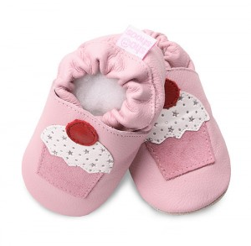
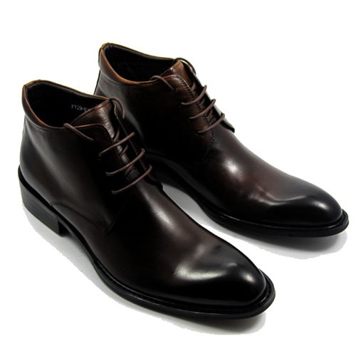
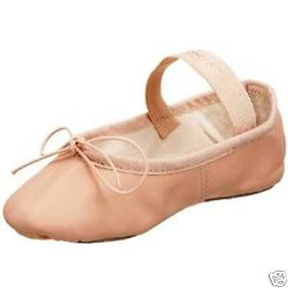
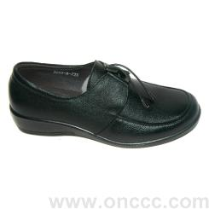
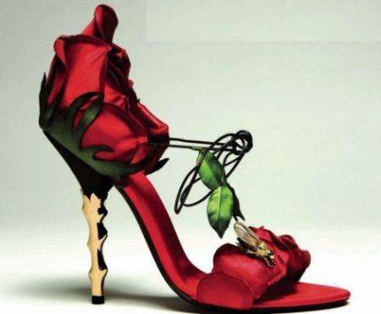
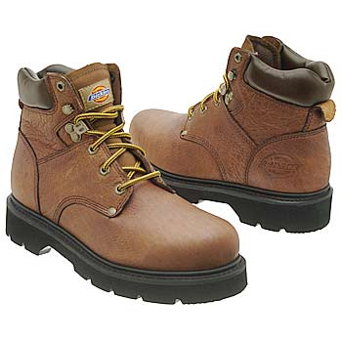
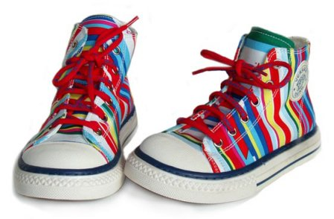
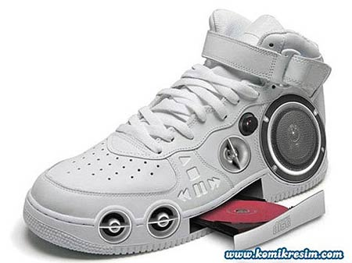
What is classification?
Classification – organizing things into groups that have meaning.

Slide 3
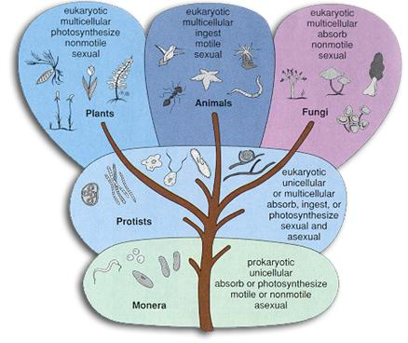
How does classification relate to taxonomy?
Taxonomy is the scientific classification system used to categorize all living organisms.
This is a universal system

Slide 4
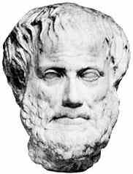
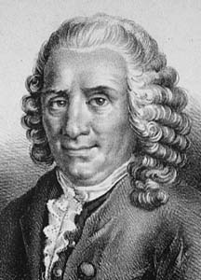
History of Classification
Aristotle
Developed the first written classification scheme
There were TWO groups – Plants and Animals
Animal group = anything that lived on land, in the water or in the air.
Plant group = based this on their different stems
Carolus Linnaeus
Developed the current classification system
His classification system is based on similarities in structure

Slide 5
The Seven Taxa
Taxon – a group or level of organization
Linnaeus’ system uses 7 taxa arranged in order from largest to smallest.
He classified organisms into two kingdoms: Animalia or Plantae
Kingdom King
Phylum Phillip
Class Came
Order Over
Family From
Genus Germany
Species Secretly

Slide 6
Binomial Nomenclature
Linnaeus’ classification system
The system we use today in science to name living organisms scientifically.
Made up of two words: Genus and species
Genus is always capitalized
Species is not capitalized
Should always be underlined when handwritten or in italics when typed.
Uses Latin

Slide 7
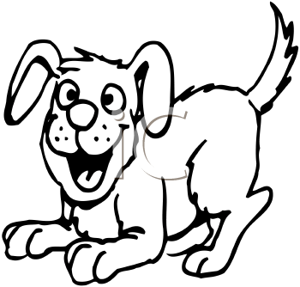
Example of a Scientific Name
Common name : Dog
Scientific Name: Canis familiaris
Genus: Canis
Species: familiaris
Kingdom: Animalia
Phylum:Chordata
Class: Mammalia
Order: Carnivora
Family: Canidae
Genus:Canis
Species: Canis familiaris

Slide 8
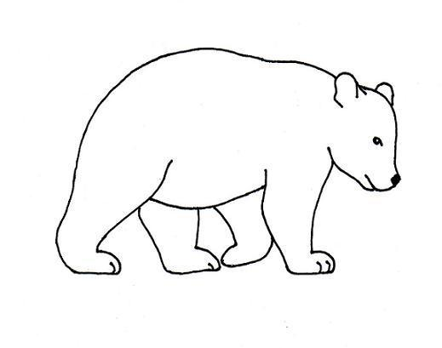
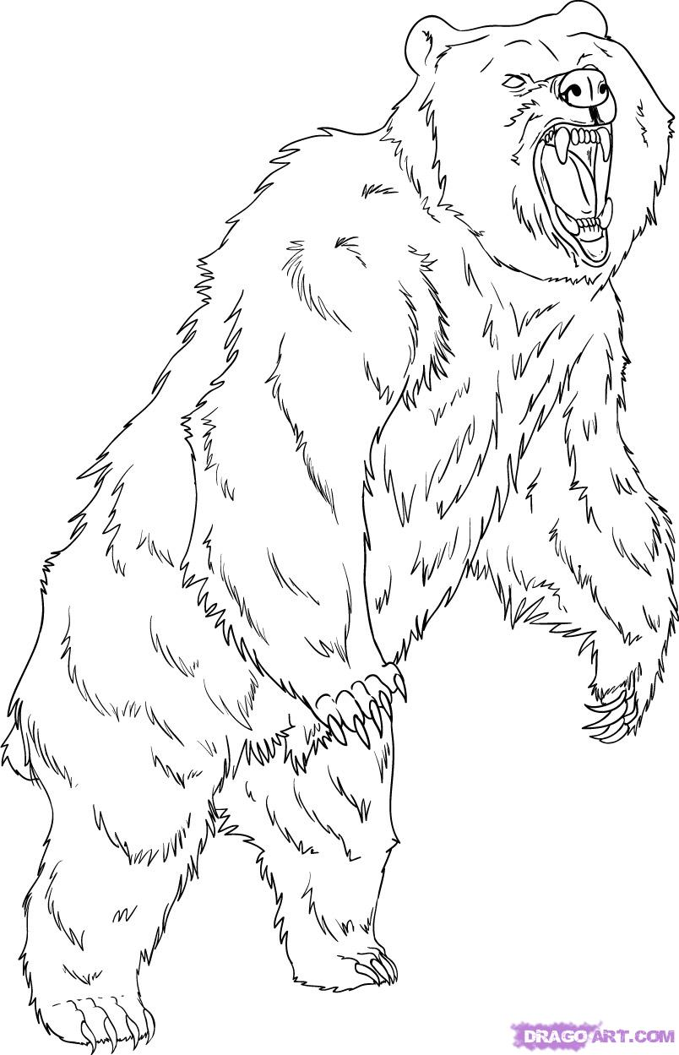
Polar Bear, Ursus maritimus
Grizzly Bear, Ursus arctos

Slide 9
Scientific Classification of Humans
Animalia
Chordata
Mammalia
Primates
Homindae
Homo
Sapiens

Slide 10
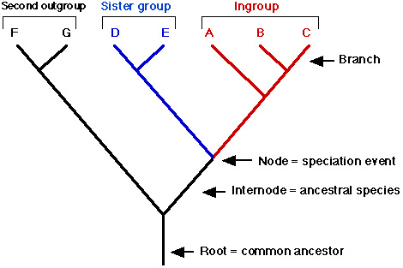
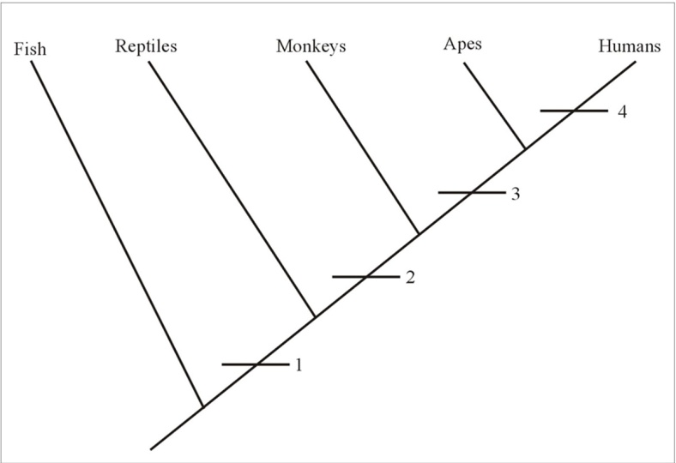
Cladogram
A cladogram shows evolutionary relationships between organisms.
Shows how closely related two animals are.

Slide 11
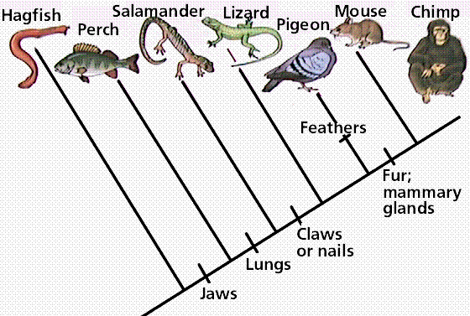
What does a perch have that a hagfish doesn’t have?
According to the cladogram, who is the chimp more closely related to, the mouse or the salamander?

Slide 12
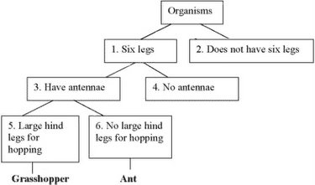
Dichotomous Key
A list of characteristics organized in pairs used to identify objects or living things.

Slide 13
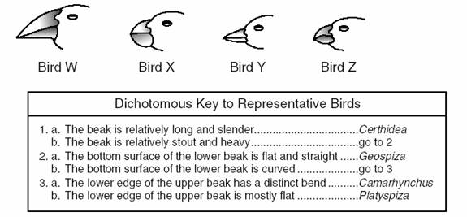
Identify Bird X

Slide 14
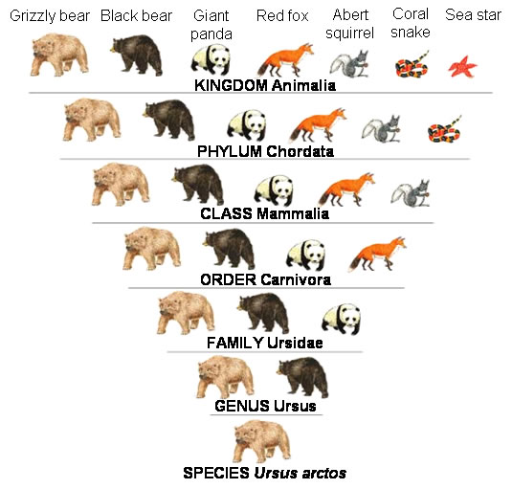
Which animal is most closely related to the grizzly bear?
Which animal is the least related to the grizzly bear?

