Slide 1
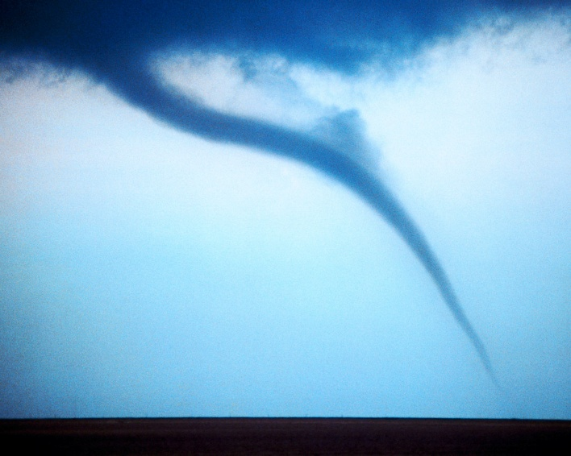
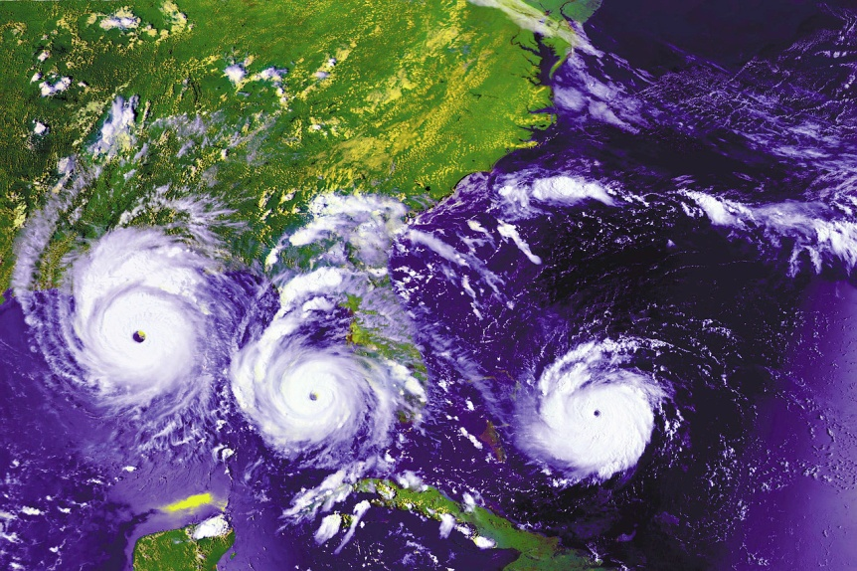

Thunderstorms, Tornadoes and Hurricanes
Honors Earth Science

Slide 2
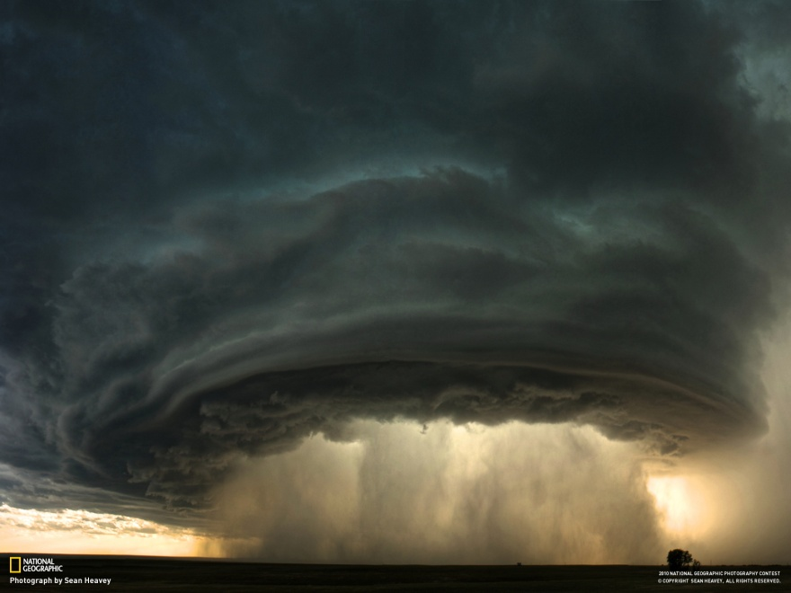
Thunderstorms
A storm with lightning and thunder.
Produced by a cumulonimbus cloud.
Usually produces gusty winds, heavy rain and sometimes hail.

Slide 3

Ingredients for a Thunderstorm
Thunderstorms need two things in order to form:
1. Warm air rising that is relatively unstable
2. Moisture

Slide 4
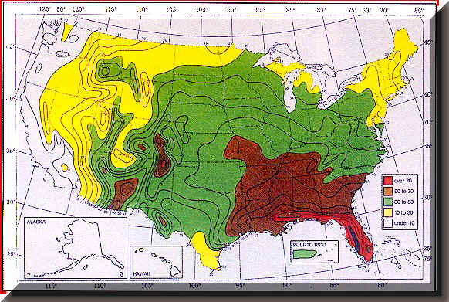
Where do most thunderstorms form?

Slide 5
Types of Thunderstorms
Air mass thunderstorms:
Short lived
Associated with mT air
Not severe
Frontal thunderstorms
Associated with cold fronts
Can happen any time of day
More severe

Slide 6
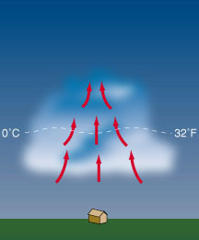
Stages of Thunderstorm Development
  Cumulus stage:
    Air rises in an updraft.
    A cloud is formed.

Slide 7
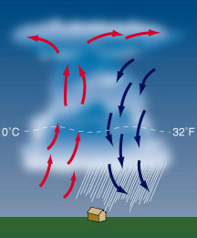
  Mature Stage:
  Precipitation occurs
  Air Cools and Sinks
  Updrafts and Downdrafts

Slide 8
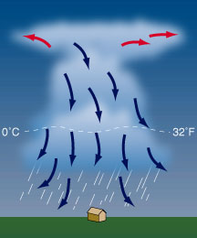
  Dissipation Stage:
  More downdrafts than updrafts
  Air no longer rises = cloud disappears

Slide 9

Storm Animation

Slide 10

Severe Thunderstorms
10% of thunderstorms are severe
The most severe type are called supercells.
Supercells: extremely powerful storms that have rotating updrafts
  Can last hours
  Strong Winds
  Can lead to tornadoes

Slide 11
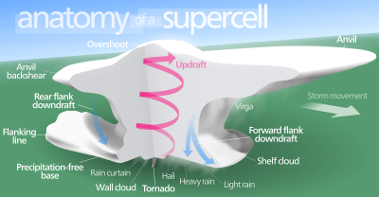

Slide 12
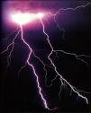
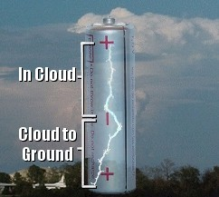
Lightning
Lightning is the electricity caused by the rapid rush of air in a cumulonimbus cloud
The cloud becomes electrically imbalanced
  There are negative charges
  on the bottom of the cloud
  The ground is positively
  charged

Slide 13
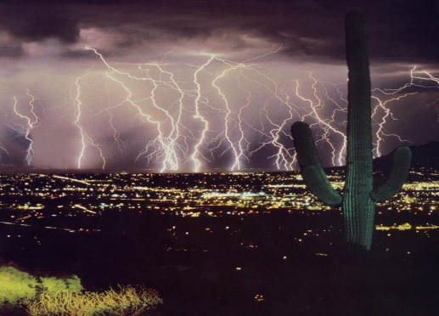
Lightning Strikes!
Stepped Leader: negatively charged zig-zags come down from the cloud
Return Stroke: positive charges moving up from the ground.
The two charges meet and you see lightning!

Slide 14
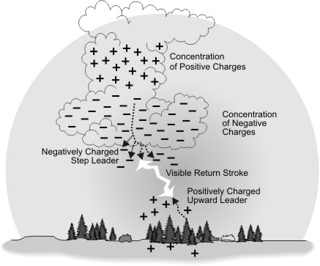

Slide 15


Slide 16
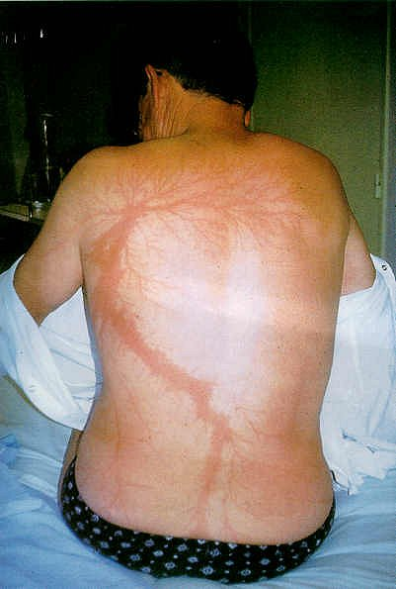
Lightning Facts - FYI
Lightning heats the air, causing it to “explode”
  You hear thunder
  Sound travels slower than light
  You see lightning before hearing thunder
Each year, Lightning causes
  7,500 forest fires
  300 injuries
  93 deaths

Slide 17

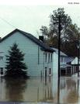
Floods
Caused by large amounts of rain in short amount of time
  Thunderstorm moves slowly
  Ground cannot soak up water as fast
#1 cause of thunderstorm deaths in the U.S. each year

Slide 18
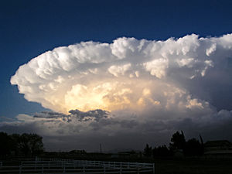
Where tornadoes form
Tornadoes form from severe rotating thunderstorms called supercells.
These storms have strong rotating updrafts.
These storms produce drenching rainfall, large hail, and strong downbursts in addition to tornadoes.
Notice the anvil shaped cloud.

Slide 19
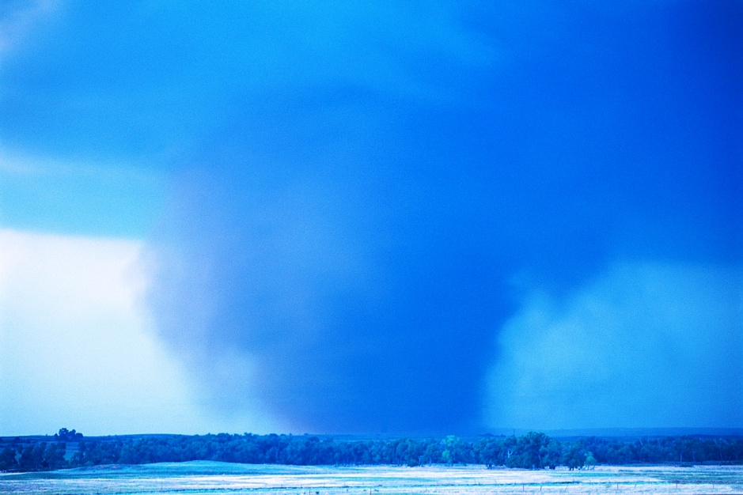
Formation of the tornado
The tornado forms beneath the wall cloud.
Sometimes the tornado can be masked by heavy rain, making it even more dangerous.

Slide 20
Stages of Tornado formation
1. Dust whirl stage
2. Organization stage
3. Mature stage
4. Shrinking stage:
  Often see tornado hook to left due to downdrafts.
5. Decay stage

Slide 21
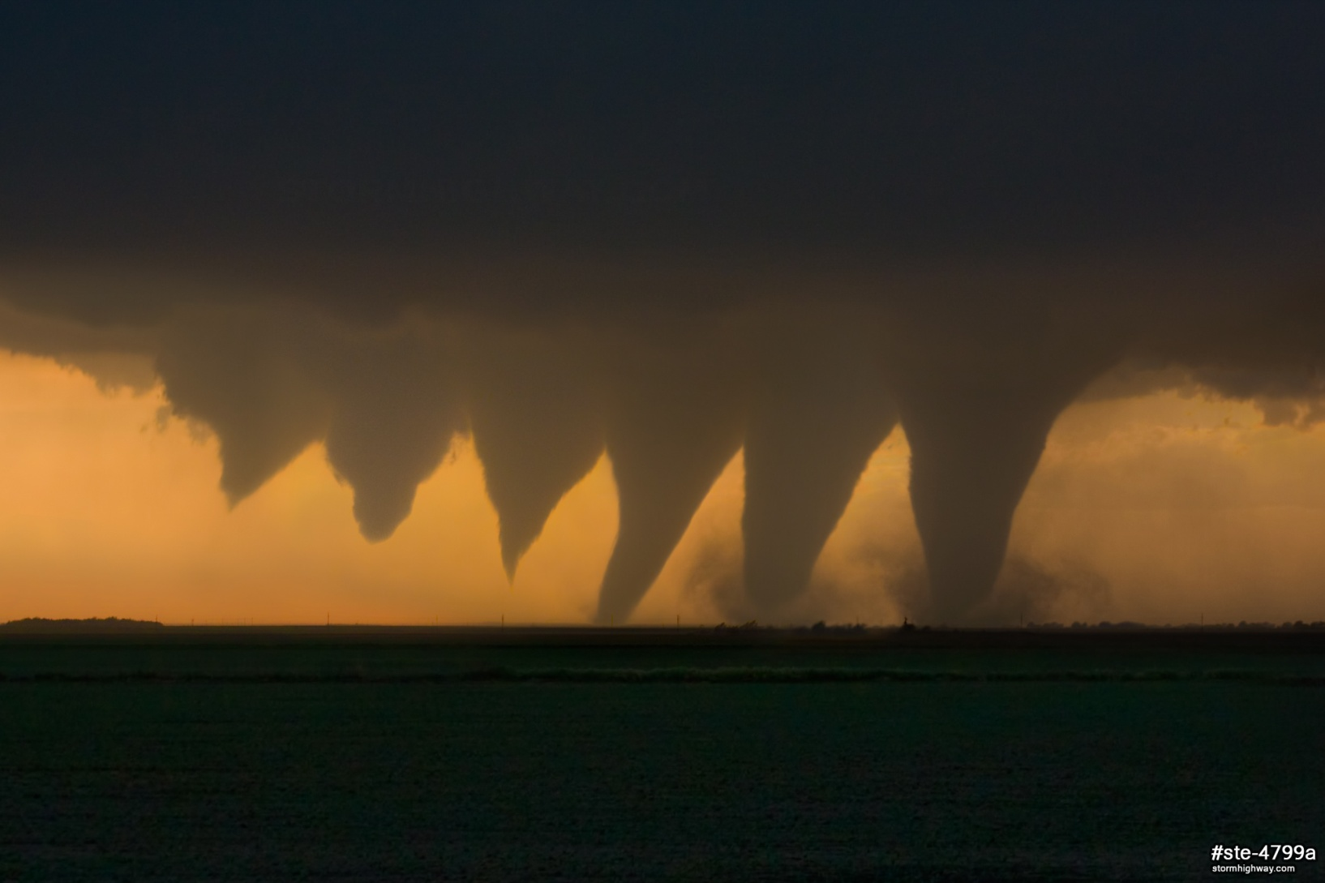

Slide 22
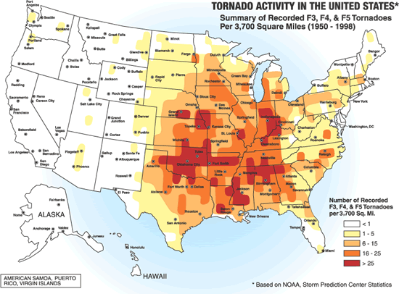

Slide 23
Fujita Scale
One way that tornadoes and hurricanes are different is how wind speed is calculated.
  In a hurricane, a plane flies in and measures wind speed. Winds are generally not more than 155 mph.
  Since tornadoes are shorter storms and scientists are not able to regularly measure wind speed, it is calculated based on the damage it does. Wind tunnel tests help determine what wind speed it takes to level or damage different structures.

Slide 24
Enhanced Fujita Scale
In 2007, the scale was streamlined to better reflect accurate wind speeds based on the damage done by the storm.
  Takes into account the quality and structure of building (it takes less to level a mobile home than it does to level a large brick building)
  There are 28 damage indicators.
  Different types of structures have their own damage indicators and their own degrees of damage.
  The old scale’s max wind speed was 318 mph and now it is listed as “200 mph or over”

Slide 25
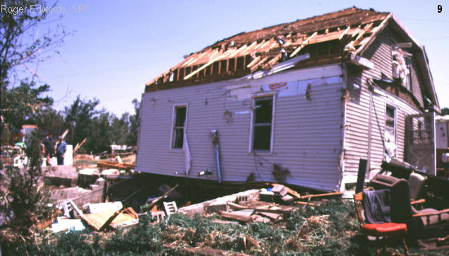
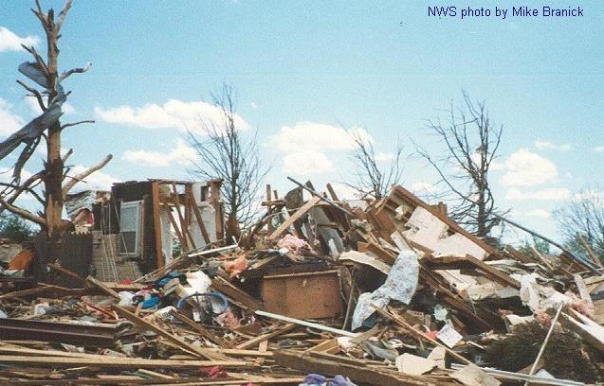
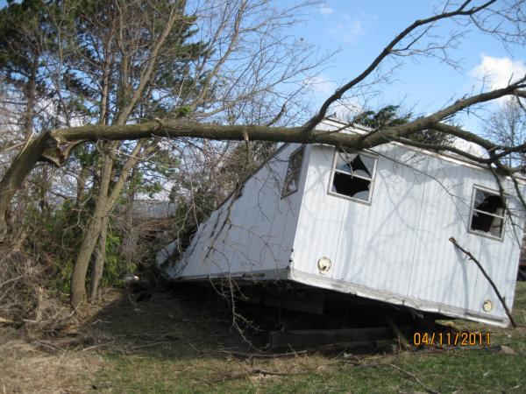
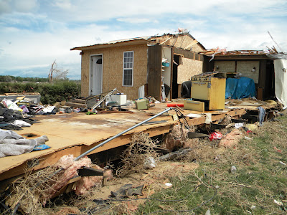
Tornado damage
F1
F3
EF1
EF2

Slide 26
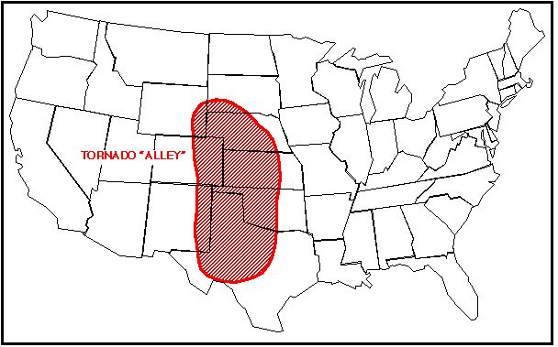
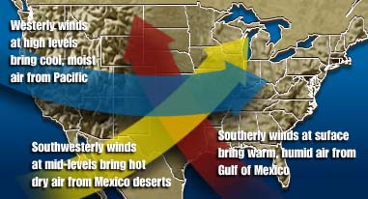
Tornado Distribution
Most form in the Spring, late afternoon and evening
Mostly central U.S.
  “Tornado Alley”

Slide 27
What is a hurricane?
Large, rotating, low-pressure storms that originate over tropical oceans.
Hurricanes are also called tropical cyclones or typhoons in other parts of the world.

Slide 28
What does a hurricane need to form?
Two factors are responsible for the formation of a tropical cyclone:
  Warm water
  A weather disturbance that causes air to rise (ex: a thunderstorm)
These factors are present in every tropical ocean except the South Atlantic and the Pacific Ocean west of South America

Slide 29
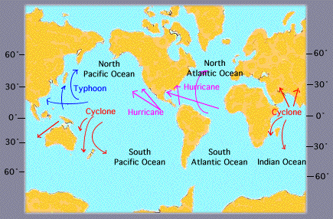
Hurricane Distribution

Slide 30
Movement of a Hurricane
Wind currents guide tropical cyclones
  Hurricanes that originate in the middle Atlantic are driven west ward by the trade winds
  They are eventually pushed northeast by high pressure systems in the oceans
  Then, in the middle latitudes, hurricanes are pushed northeast more by the westerlies
  Since water gets cooler as you move away from the equator, most hurricanes lose their energy once they leave the tropics or go over land

Slide 31
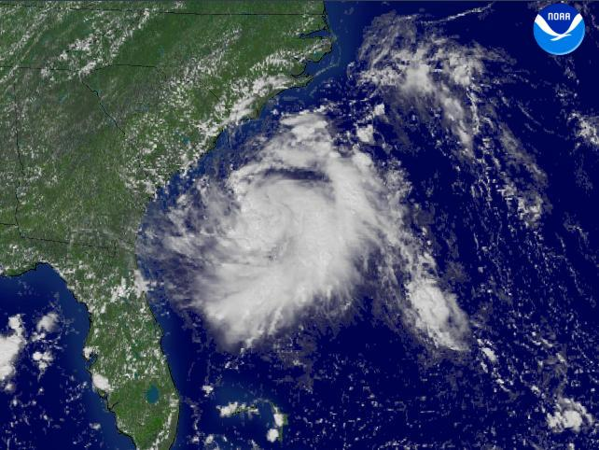
Stages of Development
Tropical disturbance that causes air to rise
  Common in the summer and early fall
  Atmospheric conditions must be right to allow the rising air to keep rising and the storm to grow.
  Most tropical disturbances never become hurricanes
Tropical Disturbance
8/27/2004

Slide 32
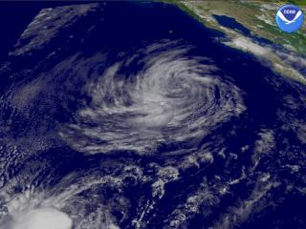
Tropical Depression
The disturbance begins to rotate around an area of low pressure and becomes a tropical depression
  Winds are less than 39 miles per hour
Tropical Depression Kevin 9/5/2003

Slide 33
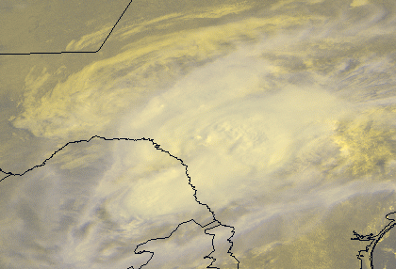
Tropical Storms
3. When wind speeds are between 39-73 mph, the storm is classified as a tropical storm
  This is when it is given a name
  The storm becomes more circular in shape
  Heavy rainfall is associated with tropical storms
Tropical Storm Charlie (1998) over Texas. 17 inches of rain fell in one town, killing 6 people

Slide 34
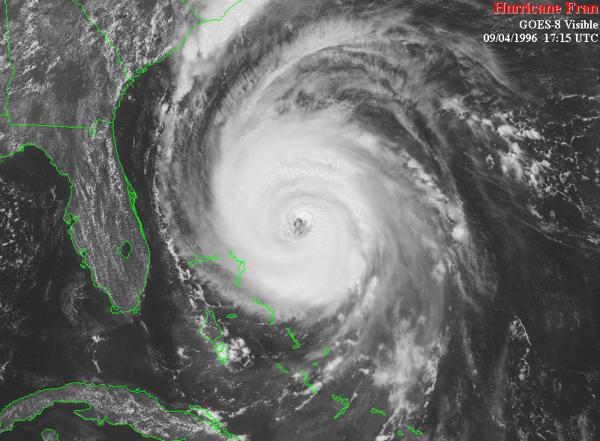
Hurricane
The pressure in the center continues to fall, and the winds around the center reach 74 mph, it is classified as a hurricane
  It becomes very easy to see the rotation

Slide 35
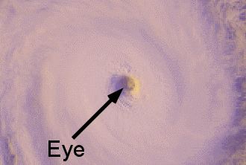
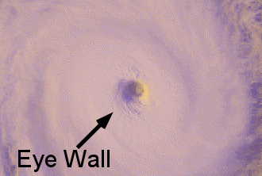
Eye and Eye Wall
Once winds reach this speed, the development of a calm center to the hurricane is formed
  This is called the eye
The area around the eye is where the strongest winds are and most rain fall
  This is called the eye wall

Slide 36
Hurricane Classification
The Saffir-Simpson hurricane scale categorizes hurricanes according to wind speed and potential damage.

Slide 37
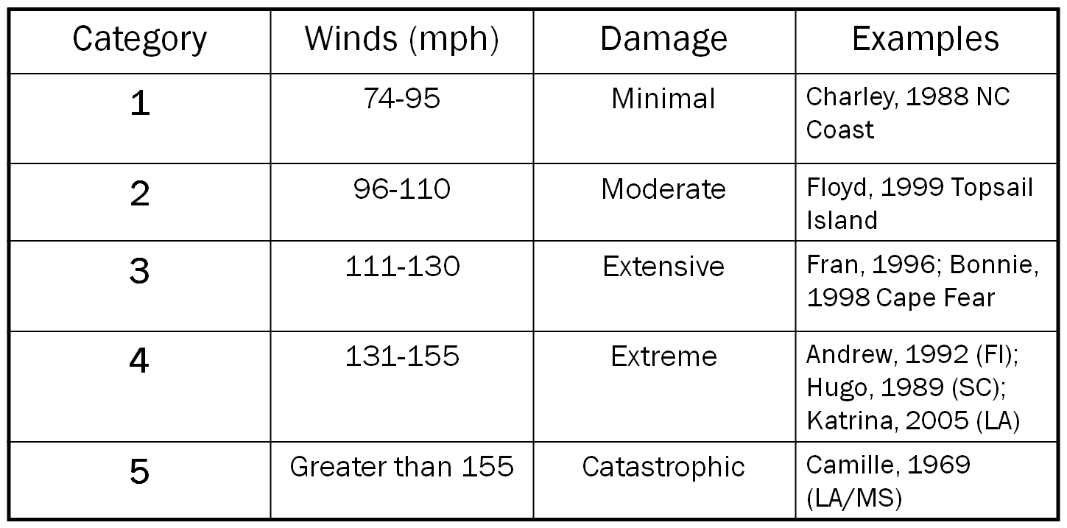
The Saffir-Simpson Scale

Slide 38

Hurricane Hazards
Storm Surges
  Hurricane-force winds drive a mound of ocean water toward coastal areas where it washes over the land
  Sometimes can reach 6 meters above sea level
  Hurricane Fran had an 8-12 foot storm surge
Floods
  Intense rain fall can often times cause floods to occur

Slide 39
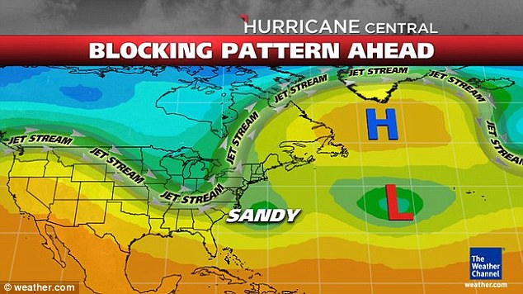

Slide 40
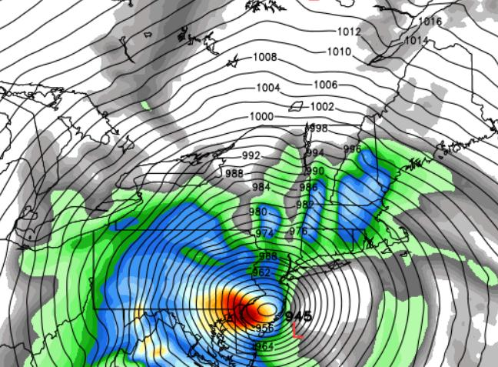
Remember that closely spaced isobars indicate high winds!

Slide 41
North Carolina and Hurricanes
Number of recorded storms affecting North Carolina
Month | Number of storms
May | 2
June | 4
July | 7
August | 10
September | 20
October | 3
November | 2

