Slide 1
Oklahoma City Bombing
By: Sarah Lezzer,
Lauren Spell,
Grace Ward

Slide 2
Timeline
April 19, 1995 (9:02 AM)- Truck bomb explosion outside of Alfred Murray Federal Building in Oklahoma City, Oklahoma
April 19, 1995 (approx. 10 AM)- Timothy McVeigh pulled over for traffic violation outside of Oklahoma and arrested for possession of a handgun
April 21, 1995- Eyewitness account names Timothy McVeigh as a bombing suspect -> McVeigh charged in connection with bombing
Terry Nichols (accomplice) surrenders in Kansas
August 8, 1995- Michael Fortier, who failed to warn authorities of bombing threat, agrees to testify in court against McVeigh in exchange for a reduced sentence
June 2, 1997- McVeigh convicted on all eleven counts of which he was charged

Slide 3
Timeline
August 14, 1997-Death penalty formally imposed on McVeigh
December 1997- Nichols found guilty on one count of conspiracy and eight counts of involuntary manslaughter. Sentenced to life in prison.
1998- Fortier sentenced to 12 years in prison
December 2000- McVeigh asked the court to halt all appeals on is behalf and set a date for his execution
June 11, 2001- McVeigh death by lethal injection (Terre Haute, Indiana)
2004- Nichols tried in Oklahoma state court and convicted of 161 counts of first degree murder and sentenced to 161 life sentences

Slide 4
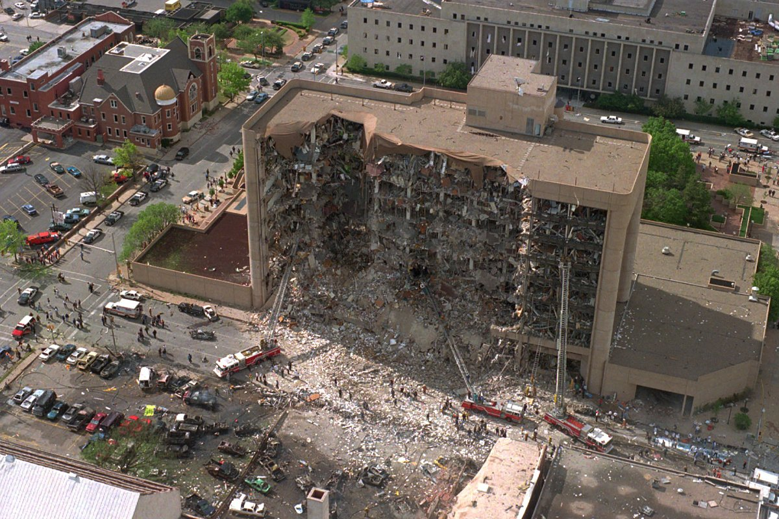
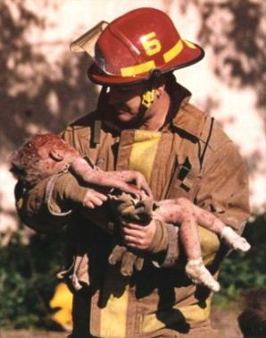
April 19, 1995- Bombing
At 9:02 AM a rental truck filled with explosives detonated in front of a large nine story building in Oklahoma City
A two week rescue effort left a death toll of 168 people
More than 650 people were injured in the bombing
The blast destroyed more than 300 buildings in the city

Slide 5
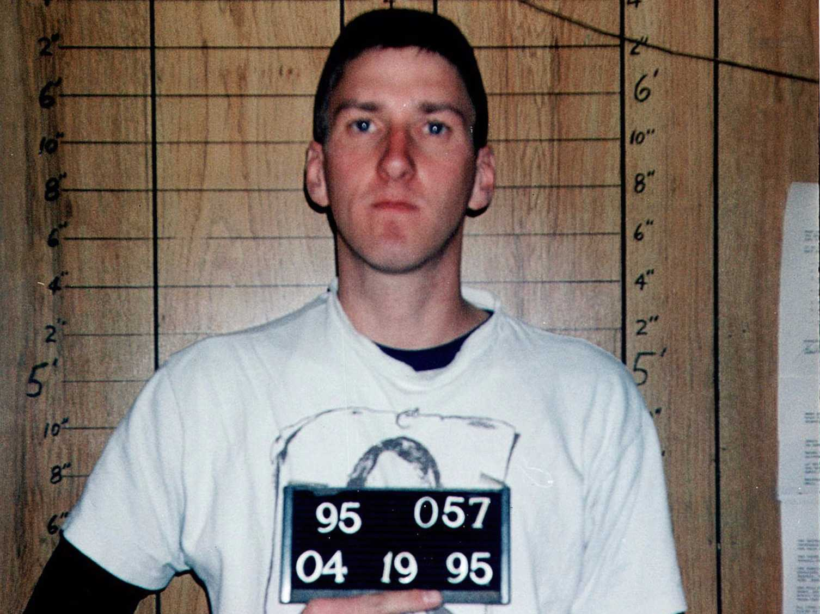
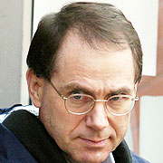
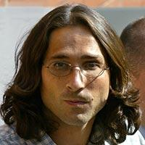
People Involved
Timothy McVeigh
Initial perpetrator and mastermind behind the bombing. Sentenced to death by lethal injection.
Terry Nichols
Military friend of McVeigh who was an accomplice to the bombing. Sentenced to 161 life terms.
Michael Fortier
Had knowledge of the bombing plans but failed to report it to law enforcement. Sentenced to 12 years in prison.

Slide 6
Research questions
How did the significance of the date play a role in the event of the bombing?
How did the background of Timothy McVeigh lead him to perpetrate such an attack?
How did McVeigh/Nichols’ radical right-wing survivalist group distort their thinking and motivate them to commit the bombing?

Slide 7
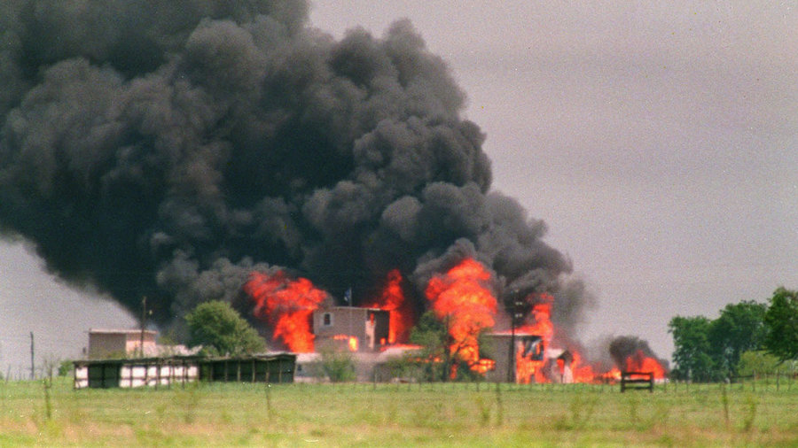
Research Question 1
On April 19th in 1993, the FBI raided a building in Waco, Texas. Over 80 members of the Branch Davidian sect were killed in the fire. McVeigh said that he targeted Oklahoma City as revenge for the raid. After he was executed, surviving members of the Davidian sect denied any support for his actions. A quote from Sheila Martin after his execution says, “I don't mourn him, and we would never support what happened in Oklahoma City…,”

Slide 8
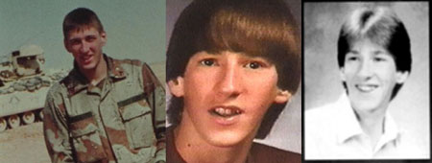
Research Question 2
Timothy McVeigh grew up in a typical home in Pendleton, New York. After his parent’s divorce, McVeigh grew close to his grandfather, who introduced him to guns. As his love of firearms began to progress, he also began to read The Turner Diaries, which fueled his paranoia regarding the government repealing the second amendment. This early childhood distrust of the government and fascination with guns as well as his military career after graduating high school supplied McVeigh with both the ability as well as the desire to pull off such a horrific attack.

Slide 9
Research Question 3
The Christian Identity movement, which was popular in rural areas of the U.S. in the 1980’s, deeply shaped McVeigh’s religious views. This group, also known for their extreme racism, is based upon The Turner Diaries, read by McVeigh in his early life. The book describes a race war, which eventually leads to the overthrowing of the government. Photocopies of portions of the book were found on McVeigh when he was arrested. The movement’s radical views on race and the government further reiterated his paranoia from his childhood and pushed him to the point where he believed that such an act would promote his political and religious beliefs.

Slide 10
Citations
Verhovek, Sam Howe. "Branch Davidians Shed No Tears for McVeigh." The New York Times. The New York Times, 12 June 2001. Web. 16 Apr. 2017.http://www.nytimes.com/2001/06/13/us/branch-davidians-shed-no-tears-for-mcveigh.html
Fantz, Ashley. "18 Years after Waco, Davidians Believe Koresh Was God." CNN. Cable News Network, 14 Apr. 2011. Web. 16 Apr. 2017.http://www.cnn.com/2011/US/04/14/waco.koresh.believers/index.html
History.com Staff. "Oklahoma City Bombing." History.com. A&E Television Networks, 2009. Web. 16 Apr. 2017. <http://www.history.com/topics/oklahoma-city-bombing>.
"Timothy McVeigh." Biography.com. A&E Networks Television, 27 June 2016. Web. 16 Apr. 2017. <http://www.biography.com/people/timothy-mcveigh-507562>.
"An Accurate Look at Timothy McVeigh's Beliefs." EthicsDaily.com. N.p., 26 Jan. 2010. Web. 16 Apr. 2017. <http://www.ethicsdaily.com/an-accurate-look-at-timothy-mcveighs-beliefs-cms-15532>.
Knickerbocker, Brad. "Oklahoma City Bombing: Right-wing Extremist Threat 20 Years Later (+video)." The Christian Science Monitor. The Christian Science Monitor, 18 Apr. 2015. Web. 16 Apr. 2017. <http://www.csmonitor.com/USA/Justice/2015/0418/Oklahoma-City-bombing-Right-wing-extremist-threat-20-years-later-video>

