Slide 1
Mutations
Ms MacCormack
Fall 2018

Slide 2
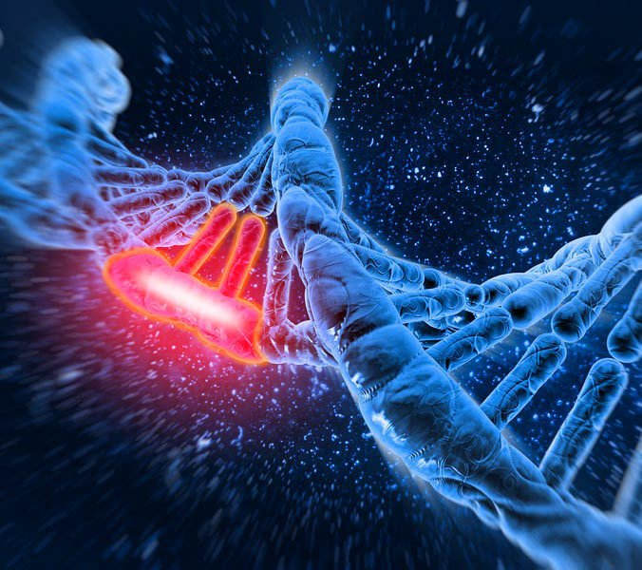
What is a mutation?
Any change in the DNA base sequence.
If it happens in gametes, it may affect an individual’s offspring/children.
If it happens in somatic cells, it may affect the individual.
May only involve a single base.

Slide 3
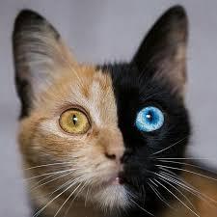
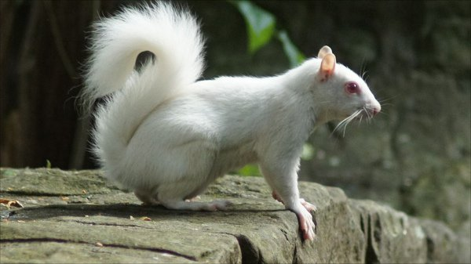
Are Mutations Helpful or Harmful?
Mutations happen regularly.
Almost all mutations are neutral.
Chemicals and UV radiation cause mutations.
Many mutations are repaired by enzymes.

Slide 4
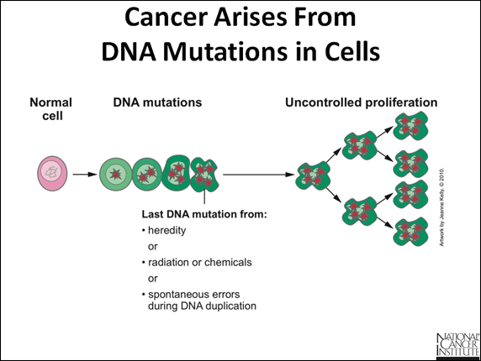
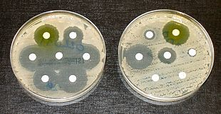
Are Mutations Helpful or Harmful?
Some types of skin cancers and leukemia result from somatic mutations.
Some mutations may improves an organism’s survival.

Slide 5
Causes of Mutations
Spontaneous
Occur during DNA replication
Caused by mutagens
Physical – radiation from UV rays, X-rays or extreme heat
Chemical – molecules that misplace base pairs or disrupt the helical shape of DNA

Slide 6
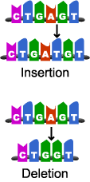
Types of Mutations
Point Mutation
Frameshift Mutation

Slide 7
Point Mutations
One base (A, T, C or G) is substituted for another.
3 possible Consequences:
Nonsense mutations – code for a stop, which can cause the premature end of translation.
Missense mutations – code for a different amino acid
Silent mutations – code for the same amino acid
Example – Sickle Cell Anemia

Slide 8
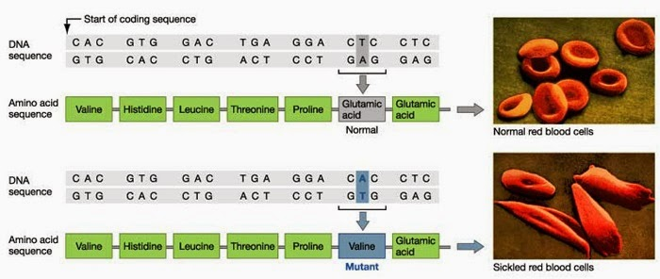
Sickle Cell Anemia
Occurs in the hemoglobin gene
Causes the hemoglobin to be abnormally shaped which leads to the red blood cell being abnormally shaped.
These red blood cells do not move easily through the blood vessels.

Slide 9
Frameshift Mutation
Insert or delete one or more nucleotides
Changes the “reading frame”
Every amino acid AFTER this mutation is changed.
Example – Cystic Fibrosis

Slide 10
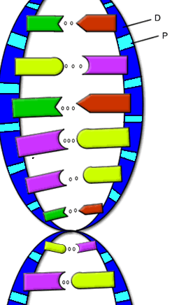
Cystic Fibrosis
The “CFTR” gene is mutated – 3 base pairs are deleted
Mutant protein is missing an amino acid and cannot fold properly
VS.

Slide 11
Key Ideas about Gene Mutations
A mutated gene will make a mutated protein
Mutant proteins are trouble!!!
They do not go where they are supposed to go.
They do not do what they are supposed to do.
Mutation of a gene = Mutant Protein
Dysfunctional proteins cause the symptoms of the disorder.

