Slide 1
Methaqualone
Grace Ward

Slide 2
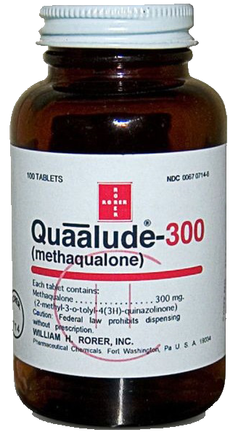
Names for Drug
Common Brand Names: Quaaludes, Sopor
Formal names: Hyminol, Isonox, Melsed, Mequin, Methadorm, Mozambin, Optimil, Parest, Renoval, Toquilone, Triador, Tuazole
Common/ Street Names: Beiruts, Disco Biscuits, Ewings, Lemmon 714, Lemons, Lennon, Ludes, Mandies, Qua, Quack, Quad, Randy Mandies, 714, Soaper, Sopes, Sporos, Vitamin Q,
Notes:
Other Formal Names: Dormutil, Melsedin, Somnafac
Other Street Names: Flamingos, Flowers, Genuines, Lovers, Wagon Wheels

Slide 3
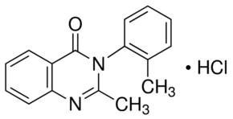
Class of Drug
Methaqualone is a synthetic, barbiturate- like, central nervous system depressant
An anxiolytic and sedative- hypnotic drug
Notes:
Depressants are substances that slow brain activity

Slide 4
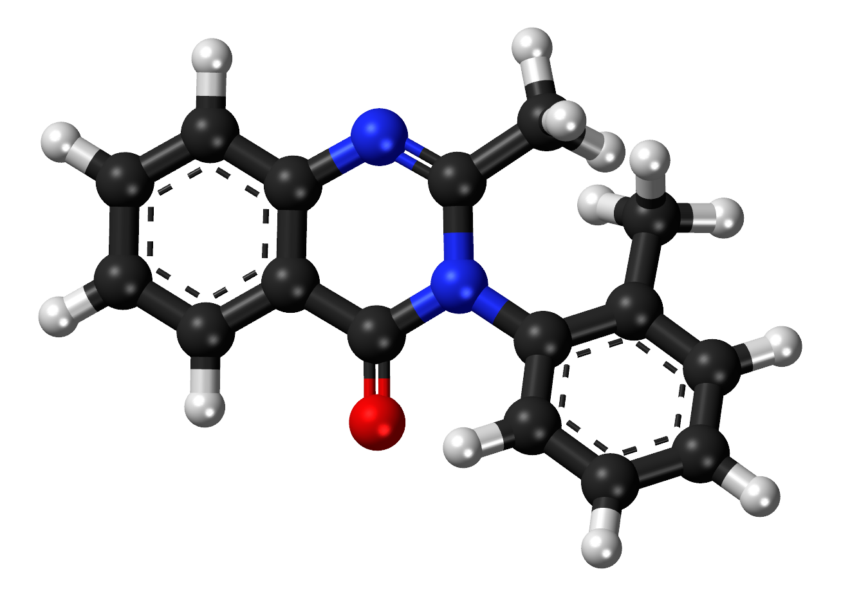
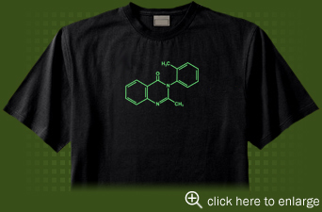
Paraphernalia Associated with Drug
The only Paraphernalia associated with Methaqualone is it’s chemical formula:
C16H14N20

Slide 5
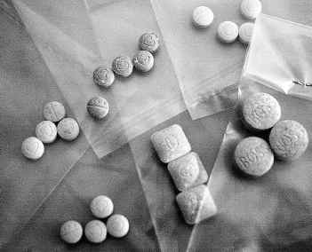
Explanation of Drug Administration
Originally a popular recreational drug in the 1960’s
Made difficult to prescribe and illegal to possess without a prescription in 1973
No longer legally available in U.S. in 1984
Now synthesized in illegal laboratories for recreational use
Since the 1970’s, Methaqualone has been taken with wine to increase its “euphoric” effects

Slide 6
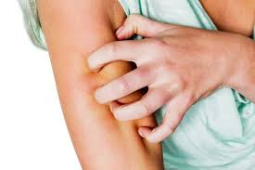
Body Effects of Drugs
Common Side Effects
Dizziness
Nausea
Vomiting
Diarrhea
Abdominal Cramps
Fatigue
Itching
Rashes
Sweating
Dry Mouth
Tingling Sensation in Limbs
Erectile Dysfunction
Overdose Effects
Seizures
Coma
Death

Slide 7
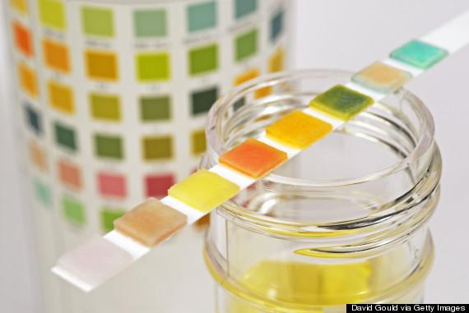
How Drug Can Be Identified
A urine test based on thin- layer chromatography screening and gas- liquid chromatography, or GLC, can detect use in individuals
Can be detected up to 72 hours after last dosage

Slide 8
Works Cited
"Where to Buy Methaqualone Online (Quaalude, Mandrax)." Buy Methaqualone (Quaalude) Online Without RX - Lowest Prices and Satisfaction Guaranteed. N.p., n.d. Web. 23 Mar. 2017.
"Quaaludes (methaqualone) Uses, Effects & History of Abuse." Drugs.com. Drugs.com, n.d. Web. 23 Mar. 2017.
"Methaqualone hydrochloride M3393." Sigma-Aldrich. N.p., n.d. Web. 23 Mar. 2017.
"How to Treat Itchy Skin Naturally During Pregnancy." American Pregnancy Association. N.p., 02 Sept. 2016. Web. 23 Mar. 2017.
Forrey, Shawn, Mel Nasrallah Says, Shawn Forrey Says, and JSaint Says. "Finding Hope." Solving the IBS Puzzle. N.p., n.d. Web. 23 Mar. 2017.
Rock, N. L., and R. J. Moore. "Methaqualone (Mandrax) abuse, urine testing, and identification: clinical correlation between a new mass urinalysis test and a military drug abuse program." The International journal of the addictions.U.S. National Library of Medicine, n.d. Web. 23 Mar. 2017.
"Protein in Urine." Pinterest. N.p., n.d. Web. 23 Mar. 2017.
"The Hindu : Andhra Pradesh / Hyderabad News : City of pearls turns `Mandrax capital'" The Hindu : Andhra Pradesh / Hyderabad News : City of pearls turns `Mandrax capital'N.p., n.d. Web. 23 Mar. 2017.
"Is White Wine Healthy for Your Heart Too? | Health News | News & Features | Wine Spectator." WineSpectator.com. N.p., n.d. Web. 23 Mar. 2017.
"Quaalude Methaqualone Molecule T-Shirt by Molecule Wear." Quaalude Methaqualone Molecule T-Shirt by Molecule Wear. N.p., n.d. Web. 23 Mar. 2017.
Skypal. "How many Quaaludes does one abalone sea snail cost?" Steemit. N.p., 12 Dec. 2016. Web. 23 Mar. 2017.

