Slide 1
GHB
Gary buchwald

Slide 2
Names for GHB
The chemical name for GHB is Gamma-Hydroxybutyric Acid
Everyday term for GHB is Sodium Oxybate
Also known as the following:
Easy Lay
Georgia Home Boy
Goop
Liquid X
Scoop
Date rape drug

Slide 3
Drug class
GHB classifies as a Central Nervous System Depressant, which will make you tired, and immobile if enough is given to you
It is also a Schedule III controlled substance in most states
But in North Carolina it is considered a schedule IV substance
In NC because it is schedule IV drug, it is punishable by $5,000 and 1 year in prison

Slide 4
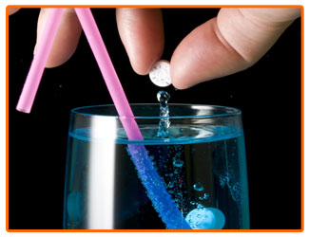
Paraphernalia
There is no paraphernalia involved with this drug because it is consumed orally, and mixed with food or drinks.

Slide 5
Effects on the body
GHB has many effects on the body
For example:
Euphoria
Sweating
Loss of consciousness
Auditory and visual hallucinations
Vomiting
Headaches
Amnesia
Confusion
Seizures
Respertory failure

Slide 6
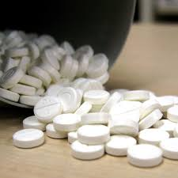
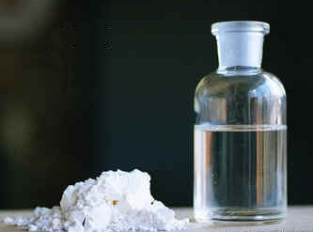
How the drug can be identified
If it is given to you unwillingly, there is not really any identifying the drug because of the colorless, odorless, and tasteless characteristics of GHB
Though you can have a blood screening done to see if the drug is in your system
When in its normal form, GHB is either a white powder, like cocaine, in pill form, and liquid form

Slide 7
Sources
Images: www.google.com
Information: https://www.drugs.com/illicit/ghb.html
http://www.drugd-tech.com/types_of_drug_paraphernalia.html#ghb
www.google.com

