Slide 1
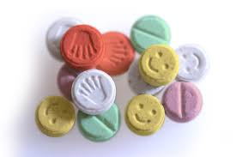
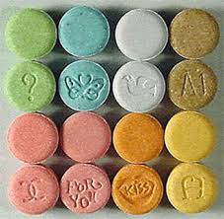
Ecstasy
Wendy Araujo

Slide 2
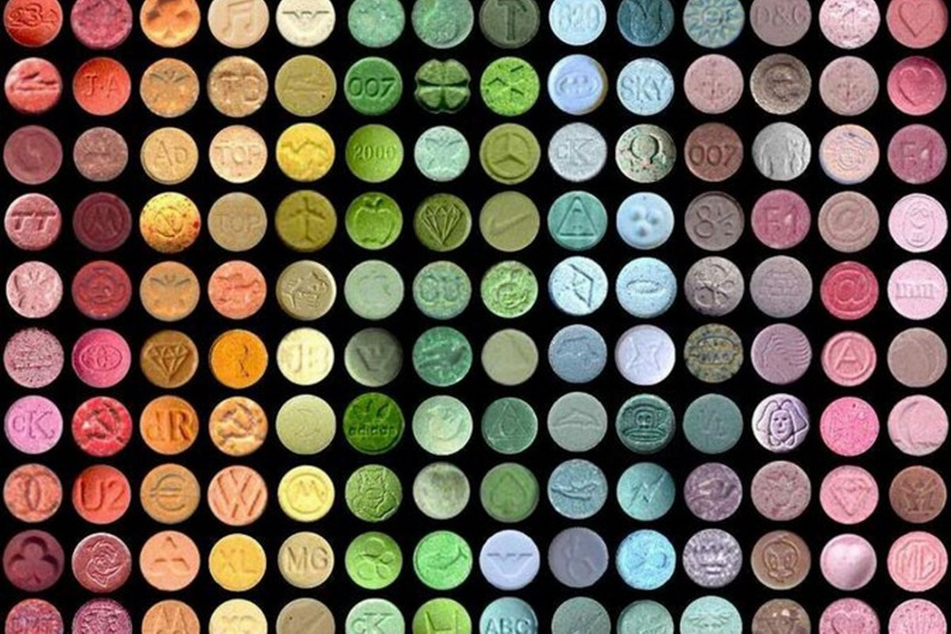
Also known as….
X, E or XTC
Molly
Skittles
Thizz
Smartees
Malcolm X
Hug Drug
Happy pill
Scooby Snacks
Vitamin E or Vitamin X
Dancing shoes
Beans
Candy
MDMA (Methylenedioxymethamphetamine)
Cuddle puddle
Drop, double drop
Raving

Slide 3
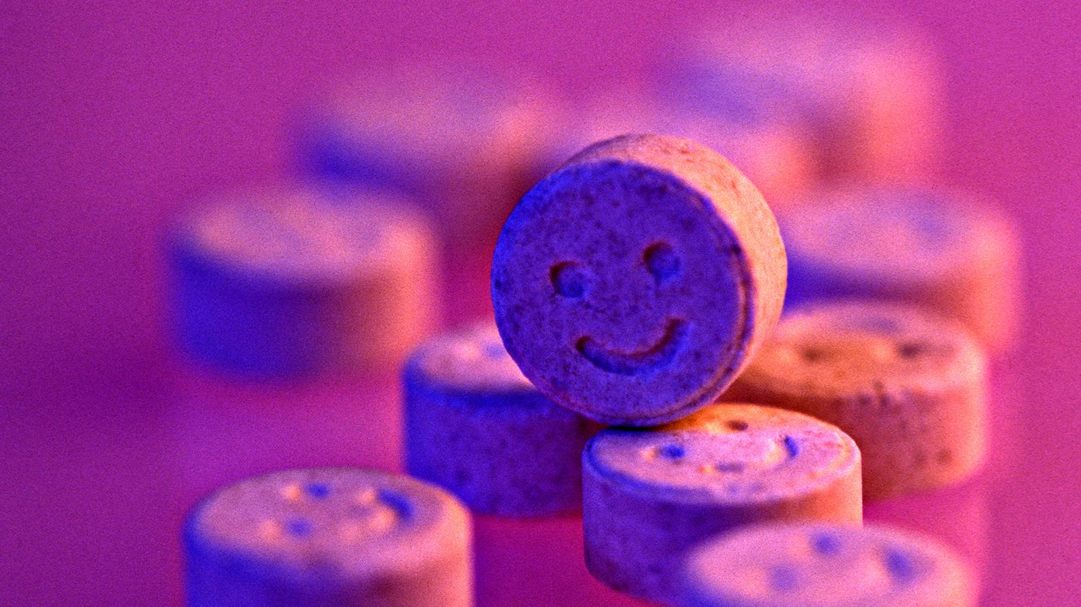
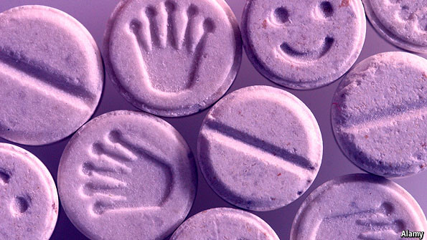
12 million
In the United States more than 12 million people have taken ecstasy.

Slide 4
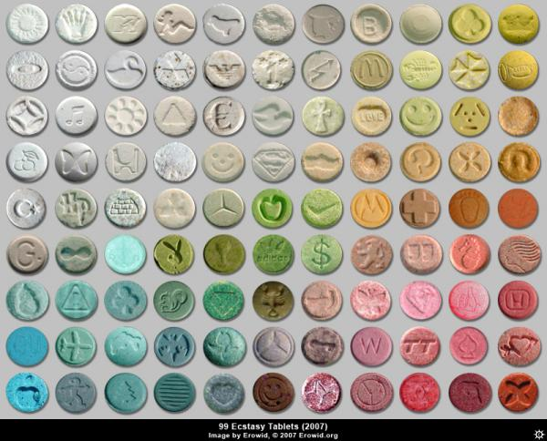
Classification
Ecstasy is classified as a Hallucinogen and Stimulant
Hallucinogen- are drugs that alter the perception, thoughts, and feelings. Their mind altering effects can change how the brain perceives the surrounding environment.
Stimulant-increases alertness, attention, and energy. Serves as a stimulus.
Ecstasy is classified as a Class A drug.
The class in which a drug is placed determines the maximum penalty for any offence involving that drug.
A Class A drug has the most severe penalty since it is considered likely to cause the most harm.

Slide 5
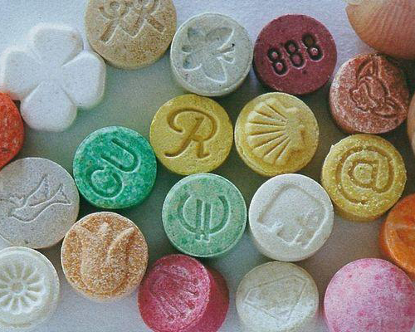
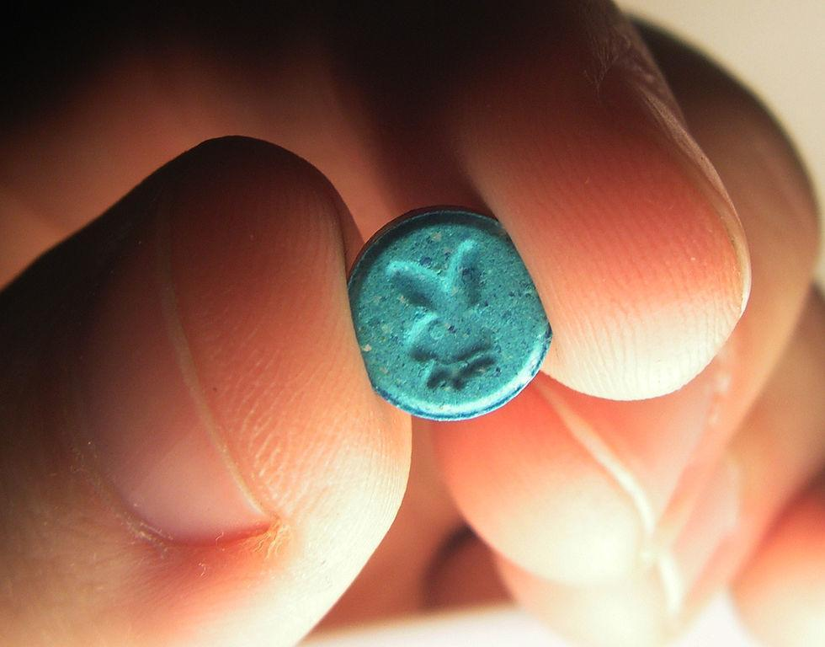
123%
According to the Drug Abuse Warning Network, there was a 123% increase in the number of emergency room visits involving MDMA from 2004 to 2009

Slide 6
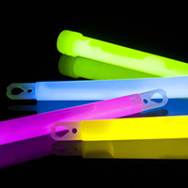
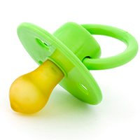
Paraphernalia
Water, Pacifiers, Lollipops, and Gum
Used to counteract side effects such as dry mouth, dehydration, and the clenching of the jaw and teeth.
Glowsticks
Used to enhance the visual effects of ecstasy
Metheanol Products (Rub and Inhalers)
Users claim in enhances the effect with the tingling sensations and methanol smell it provides.
Surgical or paint mask are also used to inhale methanol products.
Other
Mirrors, rolled up dollar bills, razorblades

Slide 7
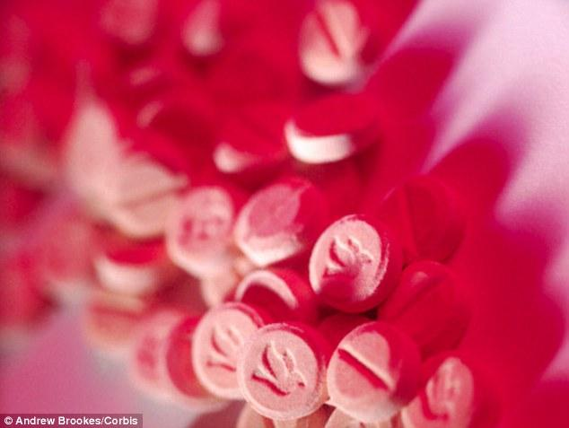
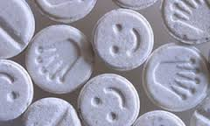
12%
An estimated 12% of young adults reported using ecstasy at least once in their lifetime.

Slide 8
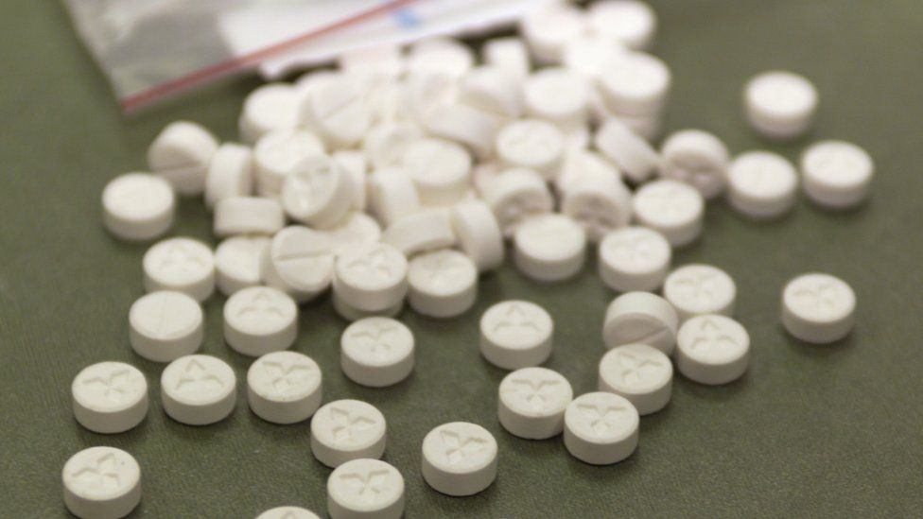
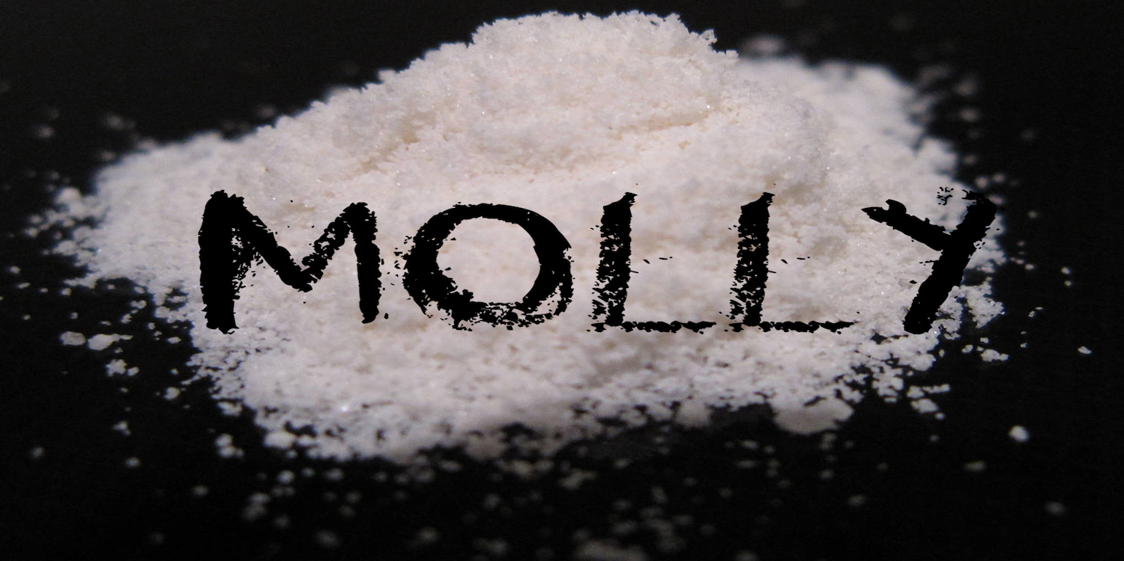
Administration
Orally
Capsule or tablet
Some swallow it through liquid
Inhaled
Snorting-Crush the pill and snort or purchase it as a powder (molly)

Slide 9
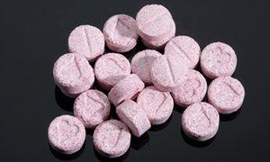
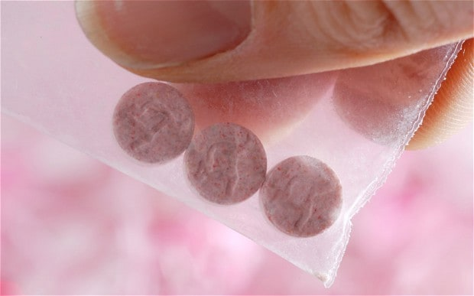
80%
Almost 80% of the emergency department visits in 2008 involved Ecstasy in combination with alcohol or other drugs.

Slide 10
Short Term Effects
Nausea
Blurred Vision
Muscle tensions
Drug cravings
Paranoia
Impaired judgment
Involuntary teeth clenching
Confusion
Severe anxiety
Sleep problems
False sense of affection
Hallucinations
Shaking and tremors
Increase in blood pressure
Depression
Faintness and chills or swelling
Higher heart rate

Slide 11
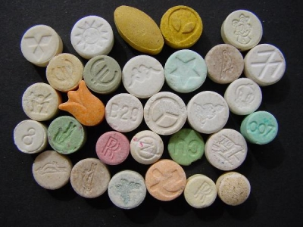
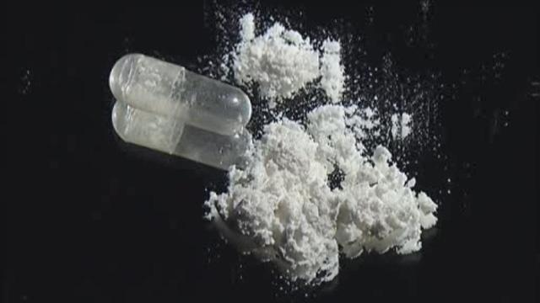
14 million
There are currently over 14 million lifetime users of the drug.

Slide 12
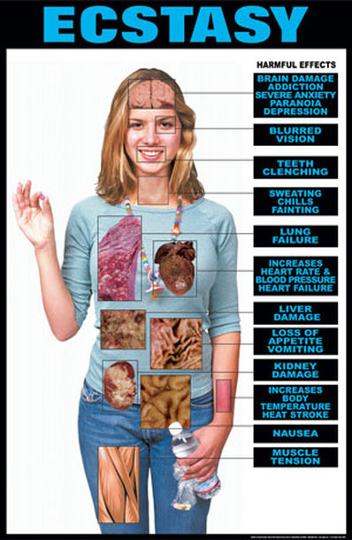
Long Term Effects
Long lasting brain damage
Convulsions
Phycosis
Memory loss
Kidney failure
Hemorrhaging
Cardiovascular collapse
Degenerated nerve branches and nerve endings
Damage portions of the brain that regulate functions such as learning, sleep, and emotion
Dependency syndrome
Death

Slide 13
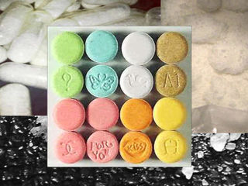
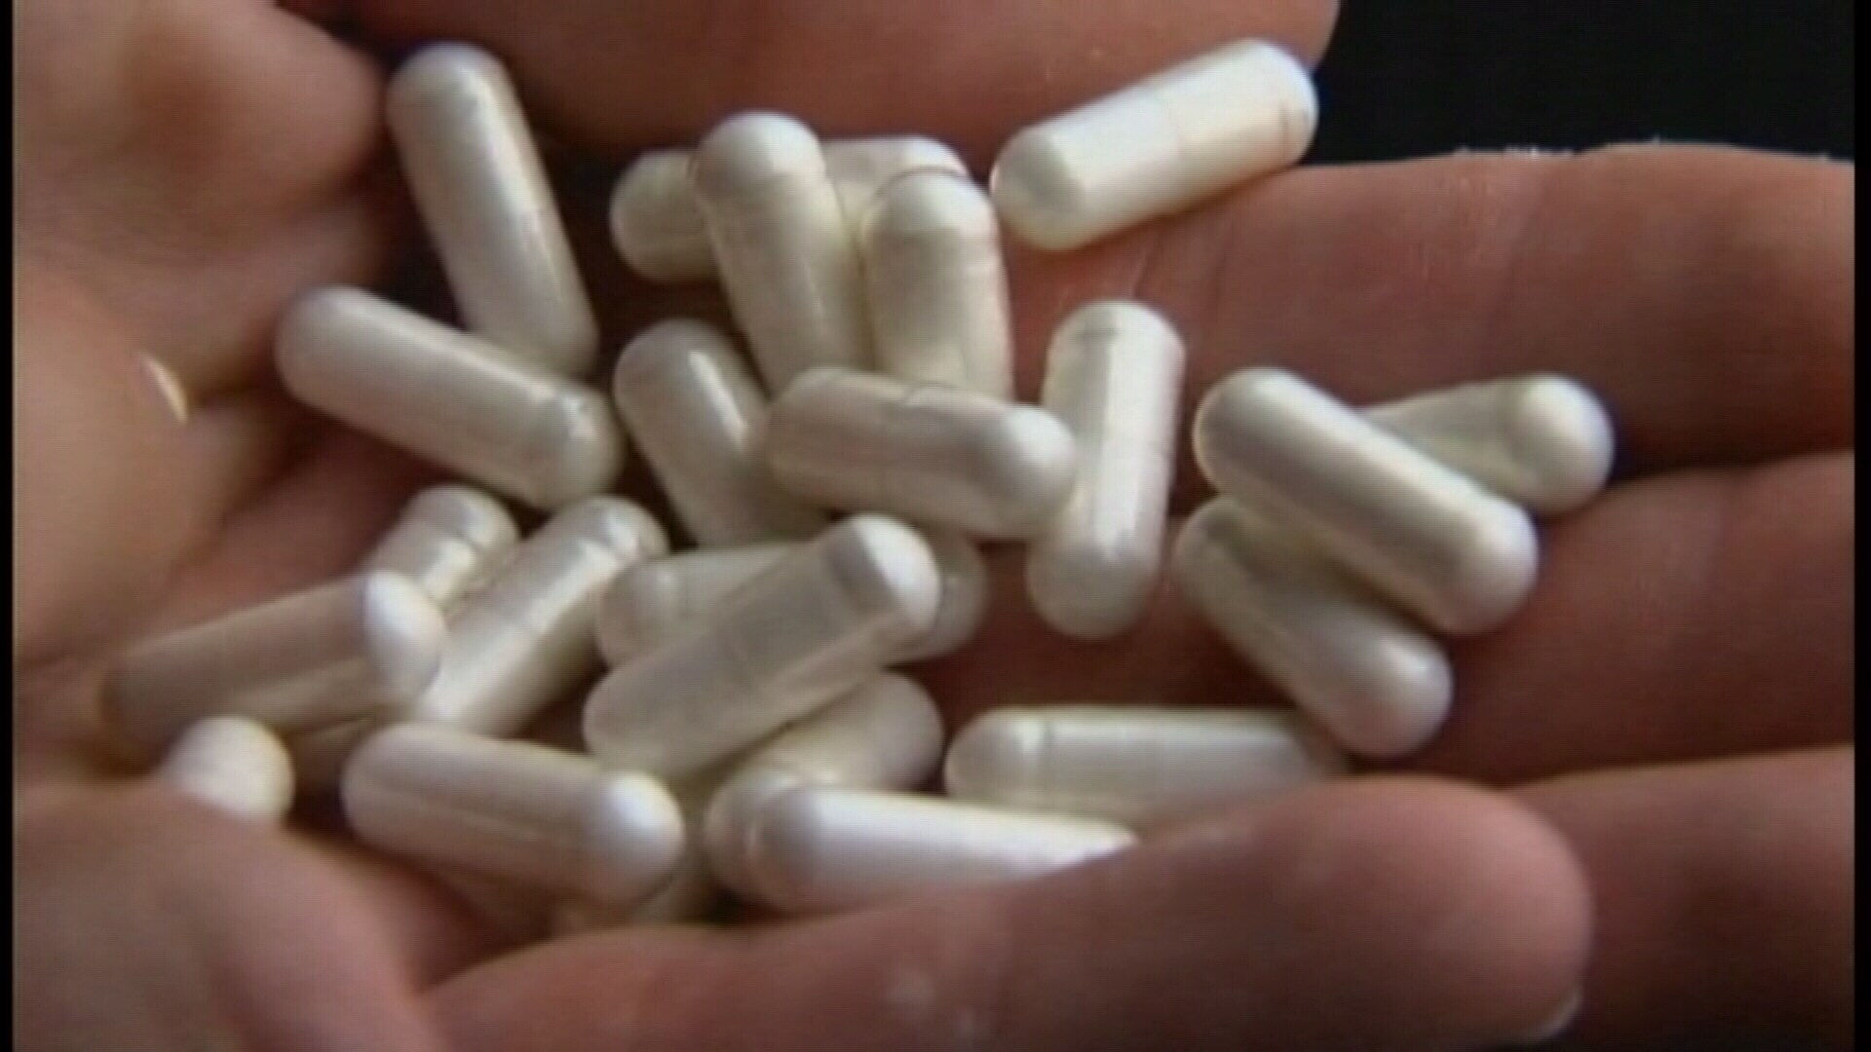
922,000
In 2011, 922,000 people reported abusing ecstasy

Slide 14
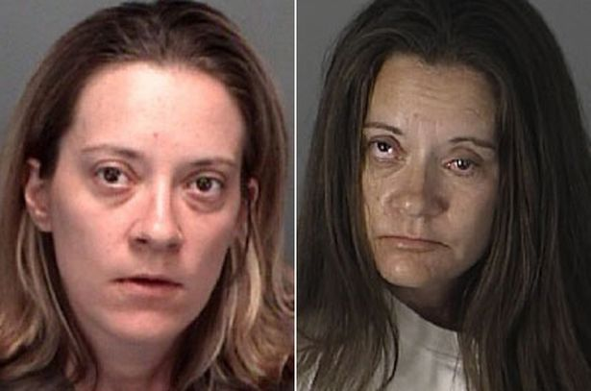
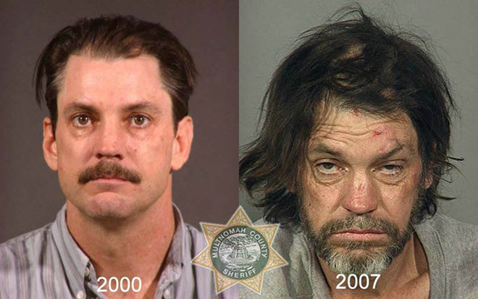
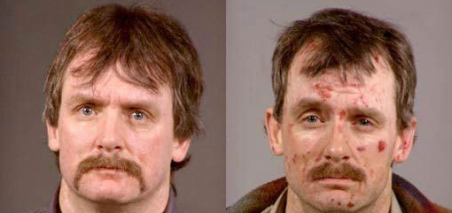
Before and After

Slide 15
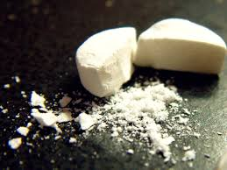
2.8 million
In 2009, 2.8 million Americans age 12 and older had abused MDMA at least once in the year prior to being surveyed

Slide 16
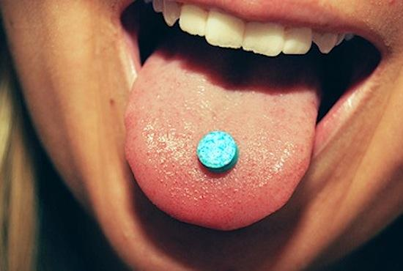
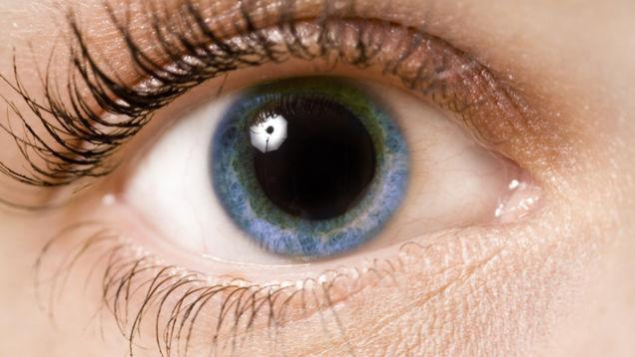
Identification
How to identify the drug
Pill, capsule, powder, and small crystals
Any paraphernalia like razor blade, methanol products, etc.
Physical changes in a person
Nausea
Chills
Sweating
Blurred vision
Dilated pupils
Muscle cramps
Tight, clenched jaw
Overheating
Collapse
MDMA test kit

Slide 17
Video
https://www.youtube.com/watch?v=2J8ORsBuM5U
https://www.youtube.com/watch?v=jEAr7ThsYew

Slide 18
Works Cited
Abuse, National Institute on Drug. "Hallucinogens." NIDA. N.p., n.d. Web. 23 Mar. 2017.
Abuse, National Institute on Drug. "MDMA (Ecstasy/Molly)." NIDA. N.p., n.d. Web. 23 Mar. 2017.
Blog, Addiction Blog Addiction. "Addiction Blog." Addiction Blog Drug RSS. Addiction Blog, n.d. Web. 23 Mar. 2017.
"Drug Classifications." Drug Classifications. N.p., n.d. Web. 23 Mar. 2017.
"Ecstasy | CESAR." CESAR: Center for Substance Abuse Research. N.p., n.d. Web. 23 Mar. 2017.
"Ecstasy." Ecstasy | FRANK. N.p., n.d. Web. 23 Mar. 2017.
"Ecstasy." EDM Sauce. N.p., n.d. Web. 23 Mar. 2017.
"Ecstasy (MDMA)." Pinterest. N.p., n.d. Web. 23 Mar. 2017.

Slide 19
Works Cited Continued
"How Long Does Ecstasy Stay in Your System." Drug Details. N.p., n.d. Web. 23 Mar. 2017.
"Know the Changes Before and After Taking Ecstasy." New Health Advisor. N.p., 25 Apr. 2016. Web. 23 Mar. 2017.
N.p., n.d. Web.
Staff, Written By Casa Palmera. "Nicknames, Street Names and Slang for Ecstasy (MDMA)." Casa Palmera. N.p., 25 Aug. 2015. Web. 23 Mar. 2017.
"Tools of the Trade: How to Spot Ecstasy Paraphernalia." Project Know. N.p., n.d. Web. 23 Mar. 2017.
"Various Street Names for Ecstasy You Must Know." New Health Advisor. N.p., 03 Sept. 2015. Web. 23 Mar. 2017.

