Slide 1
Ecological Interactions
5.01 Investigate and analyze the interrelationships among organisms, populations, communities and ecosystems

Slide 2
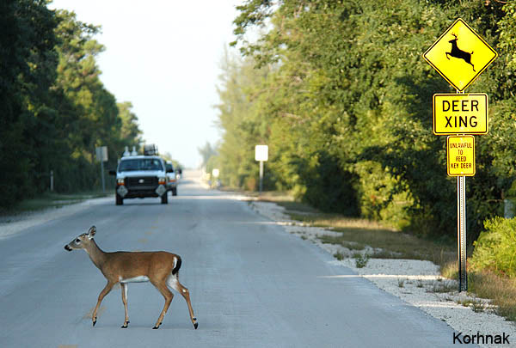
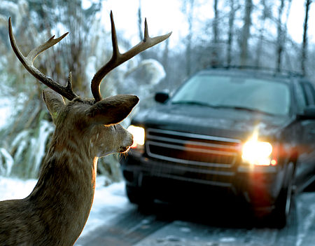
What is an ecological interaction?
An ecological interaction is the effect an individual of one species may exert on an individual of another species

Slide 3
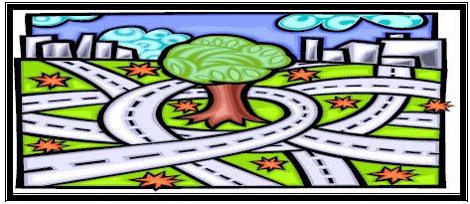
Why are ecological interactions important?
Ecological interactions can affect distribution and abundance of organisms.

Slide 4
Types of Interactions
There are 3 main types of interactions:
Competition
Predation
Symbiosis

Slide 5
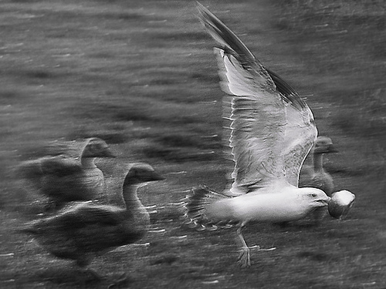
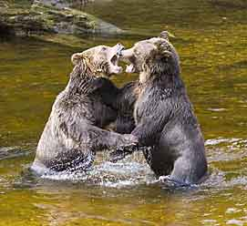
Competition
Occurs when two species share a requirement for a limited resource.

Slide 6
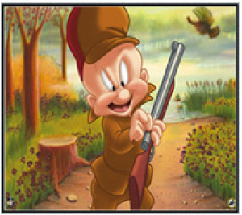
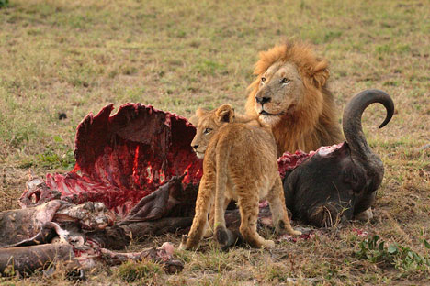
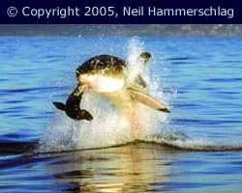
Predation
When one species feeds on another species.
Predator – organism that does the eating.
Prey – organism that gets eaten.

Slide 7
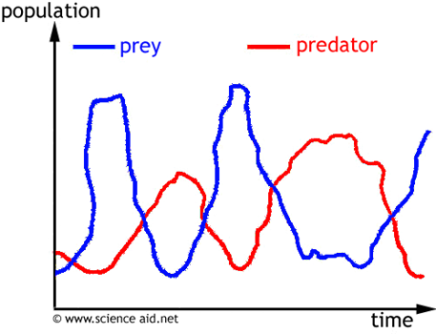
Predator Prey Graph

Slide 8
Symbiosis
A symbiotic relationship is when two
organisms of different species “live” together.
There are three types of symbiosis:
Mutualism
Commensalism
Parasitism

Slide 9
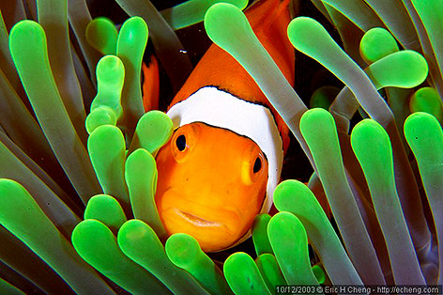
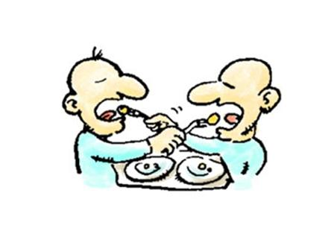
Mutualism
Two different species live together and BOTH benefit. ☺ ☺

Slide 10
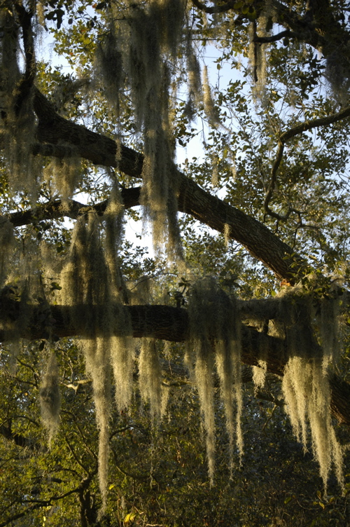
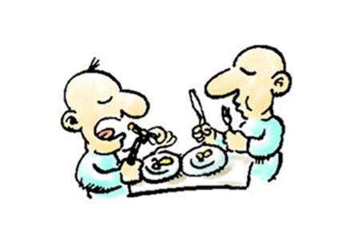
Commensalism
One benefits and the other is unaffected

Slide 11
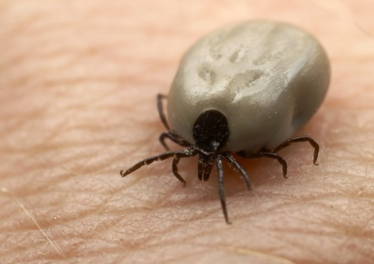
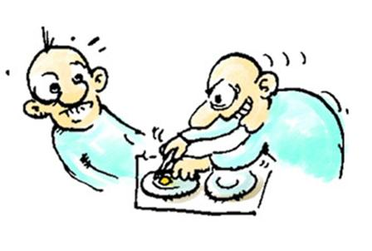
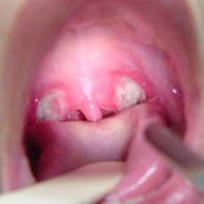
Parasitism
One benefits and one is harmed
The one that benefits is the parasite.
The host is the organism in which the parasite lives.
If the host dies, so does the parasite, DUH!

