Slide 1
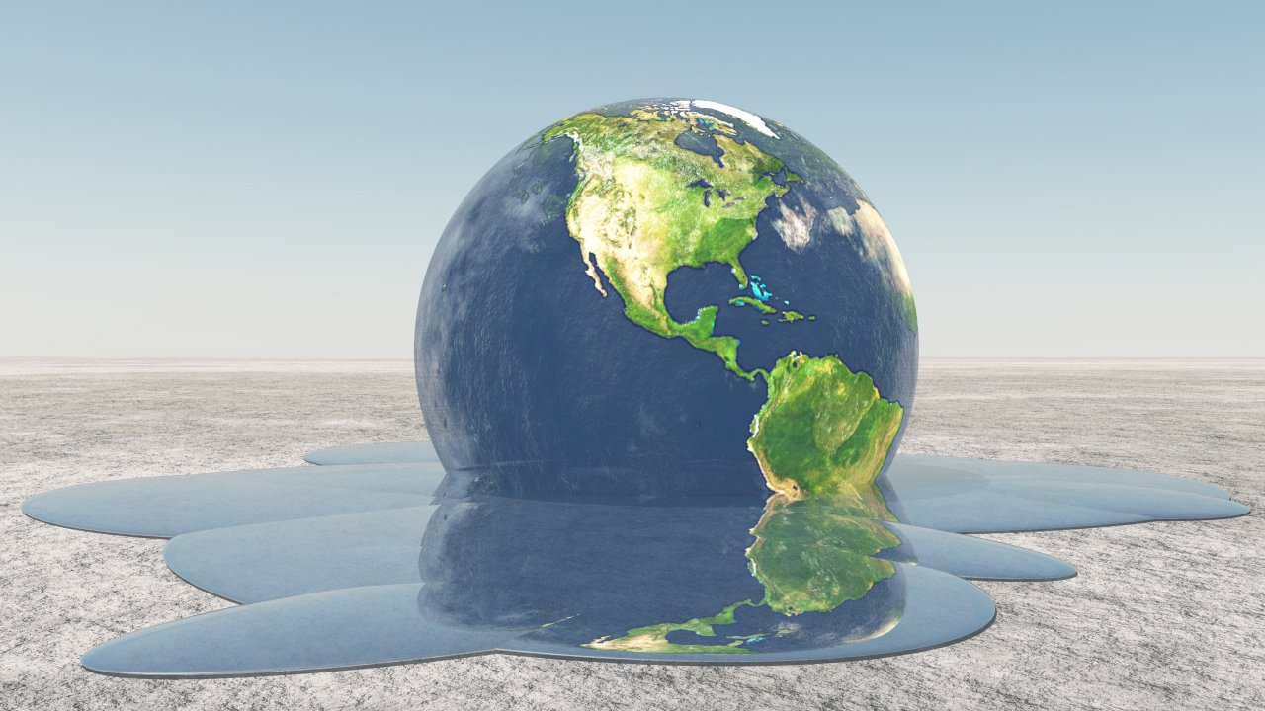
Climate Change

Slide 2
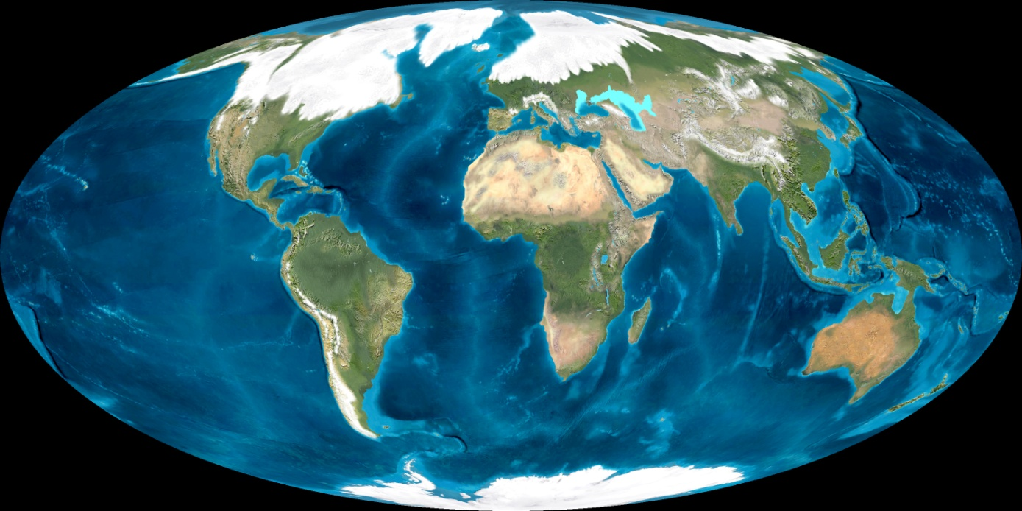
Earth during the last glacial period
Climate has changed throughout Earth’s history.
Fairly small temperature changes can have major effects on global climate.
Temp. during glacial periods was only about 10˚F less than current average temperatures.
Temp. during interglacial periods was only about 2˚F higher than today.

Slide 3
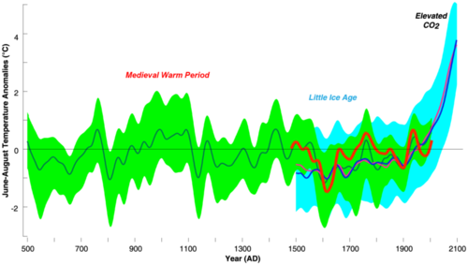
Since the last ice age, global temperatures have risen about 4˚F.
Glaciers are retreating and sea level is rising.
The graph is a compilation of 5 reconstructions (the green line is the mean of the five records) of mean temperature changes. This illustrates the high temperatures of the Medieval Warm Period, the lows of the Little Ice Age, and the very high (and climbing) temperature of this decade.

Slide 4
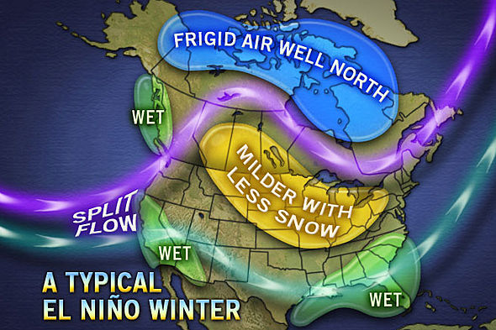
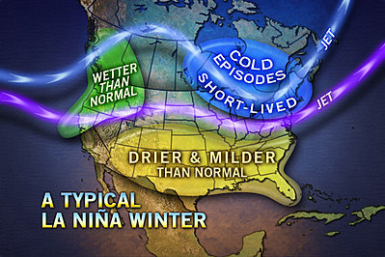
Short Term Climate Changes
The largest and most important of these is the oscillation between El Niño and La Niña conditions.

Slide 5
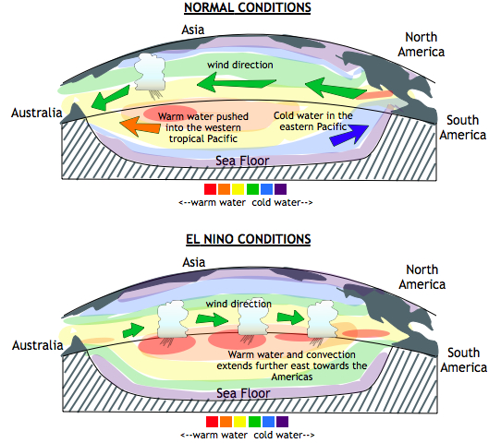
El Niño
El Niño cycles every 2-7 years and last 1-2 years.
Normal year- Trade Winds blow East to West across the Pacific.
In an El Niño year- Trade Winds weaken and reverse direction, blowing East.
Warm water moves eastward across the Pacific Ocean and collects along South America.
With warm low-density water at the surface, upwelling stops.
Notes:
Without upwelling, nutrients are scarce and plankton populations decline. Since plankton form the base of the food web, fish cannot find food, and fish numbers decrease as well. All the animals that eat fish, including birds and humans, are affected by the decline in fish.

Slide 6
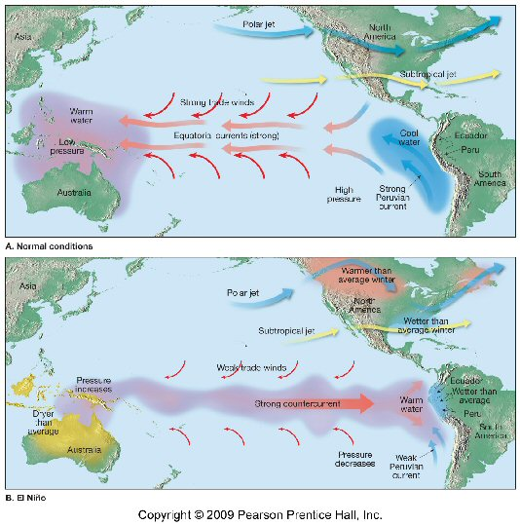

Slide 7
El Niño changes global climate patterns by altering:
Atmospheric circulation
Oceanic circulation
Some regions receive more than average rainfall
West coast of North and South America, the southern United States, and Western Europe
Drought occurs in other regions
Parts of South America, the western Pacific, southern and northern Africa, and southern Europe.

Slide 8
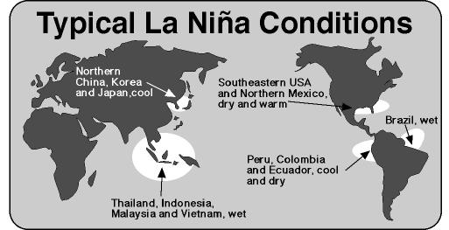
An El Niño cycle lasts 1-2 years.
Normal circulation patterns usually resume.
If circulation patterns bounce back quickly and extremely, a La Niña Develops.

Slide 9
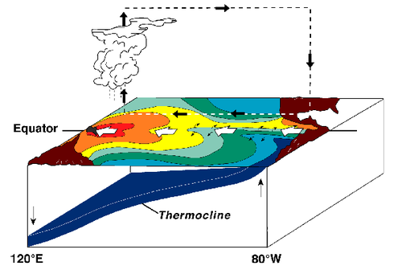
La Niña
Trade Winds moves from east to west and warm water piles up in the western Pacific Ocean.
Circulation patterns are the same as a normal year, but more extreme.
Cold water reaches farther into the western Pacific than normal.

Slide 10
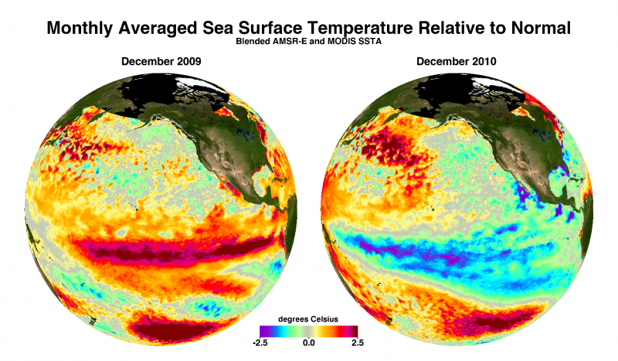
http://www.wftv.com/videos/weather/el-nino-la-nina-shift/vc8kD/

Slide 11
Long Term Climate Change
Caused by changes:
in the amount of energy the Sun produces over years.
in the positions of the continents over millions of years.
in the tilt of Earth's axis and orbit over thousands of years.
that are sudden and dramatic because of random catastrophic events, such as a large asteroid impact.
in greenhouse gases in the atmosphere, caused naturally or by human activities.

Slide 12
Solar Variation
The amount of energy the Sun radiates is variable.
Sunspots are magnetic storms on the Sun’s surface that increase and decrease over an 11 year cycle.
There is no known 11 year cycle in climate variability.
Variation is tiny compared to total amount of solar radiation.
The Little Ice Age (14-19th centuries) does correspond to a time when there were no sunspots.

Slide 13
Plate Tectonics
Over millions of years as seas open and close, ocean currents may distribute heat differently.
When continents separate heat is more evenly distributed.
When continents are located near the poles, ice can accumulate, leading to a global ice age.
Volcanic eruptions send small particles and ash into the atmosphere, which can block sunlight.

Slide 14
Milankovitch Cycles
Are a variation in Earth’s position relative to the Sun.
Due to Earth’s orbit, tilt, and wobble
Earth’s Orbit:
The shape of the orbit appears to change in cycles of 100,000 years – it becomes less elliptical and more circular.
If it is more elliptical, there is a greater difference in solar radiation between winter and summer.
When the orbit is more circular, the difference between seasons is more moderate.

Slide 15
Earth’s Tilt:
The tilt varies about 1 degree every 41,000 years.
Ranges from 22.1° to 24.5°
The current tilt is about 23.5°
When the tilt angle is smaller, summers and winters differ less in temperature.
An increase in tilt will be the opposite.
Earth Wobbles:
Over a period of 27,000 years, the Earth’s axis might tilt in the other direction or “wobble”
Northern Hemisphere points toward the Sun when the Earth is closest to the Sun.
Summers are much warmer and winters are much colder.
Opposite extreme: Northern Hemisphere pints toward the Sun when farthest from the Sun.
Chilly summers and warmer winters

Slide 16
When these three variations are charted out, a climate pattern of about 100,000 years emerges.
Ice ages correspond closely with Milankovitch cycles.
Since glaciers can form only over land, ice ages only occur when landmasses cover the polar regions.
Therefore, Milankovitch cycles are also connected to plate tectonics.

Slide 17
Greenhouse Gas Levels
Greenhouse gas levels have varied throughout Earth’s history.
Natural processes add & remove CO₂ from the atmosphere
Processes that remove CO₂
Absorption by plant and animal tissue
Processes that add CO₂
Volcanic eruptions
Decay or burning organic matter

Slide 18
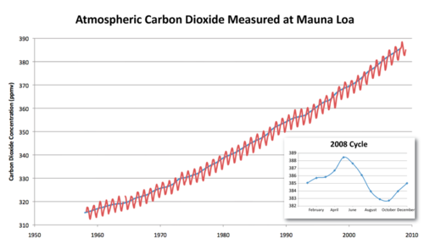
slash-and-burn agriculture- clearing and burning of rainforests for agriculture
Increases atmospheric CO₂:
Fewer trees to remove CO₂ from the atmosphere
Burning the trees releases the stored CO₂ back into the atmosphere
The Keeling Curve shows the increase in atmospheric CO₂ on Mauna Loa volcano since measurements began in 1958.
The blue line shows yearly averaged CO₂.
The red line shows seasonal variations in CO₂.

Slide 19
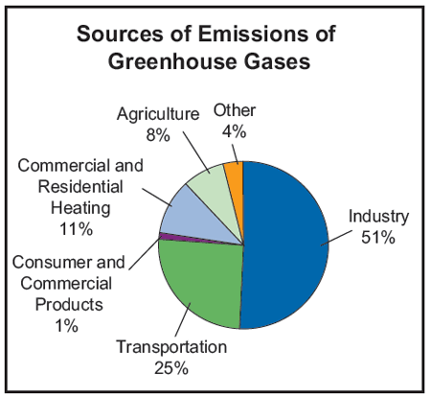
Greenhouse Gases
CO₂ is the most important greenhouse gas that human activities affect because it is so abundant.
Methane: released from raising livestock, rice production, and the incomplete burning of rainforest plants.
Chlorofluorocarbons (CFCs): human-made chemicals that were invented and used widely in the 20th century.
Tropospheric ozone: from vehicle exhaust, it has more than doubled since 1976.

Slide 20
Global Warming
Temperatures are increasing (have since the last ice age)
Rate of increase has been more rapid in the past century
Has risen even faster since 1990
Average global temperature has increased 1.5˚F between 1880 and 2010.

Slide 21
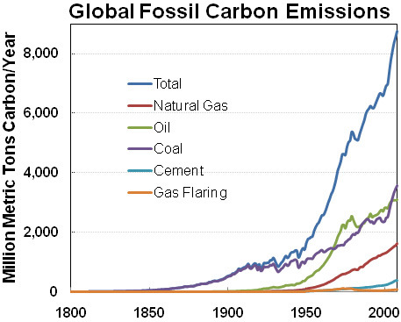
Industrial Revolution around 1850
Notes:
CO2 released by different fossil fuels

Slide 22
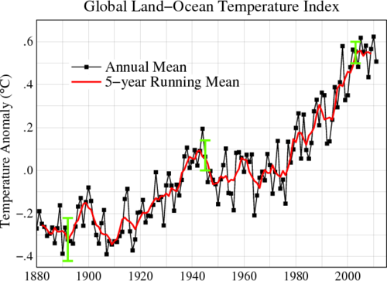
Recent temperature increases show how much temperature has risen since the Industrial Revolution began.

Slide 23
Future Warming
The amount CO₂ levels will rise in the next decades is unknown.
Depends on:
Technological advances
Lifestyle changes (developed nations)
Lifestyle improvement (developing nations)

Slide 24
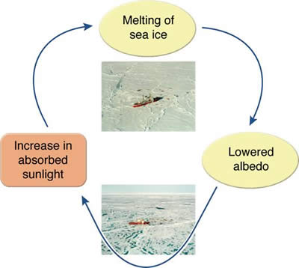
Computer model predictions:
If nothing is done to decrease emissions, and they continue at the current rate.
2050 = temps increase by 0.9-3.6˚F
2100 = temps increase by 3.5-8˚F
Temperature increase will not be uniform.
A rise of 5˚F would result in 1-2˚F increase at the equator, and a 12˚F increase at the poles.

Slide 25
Consequences of Global Warming
Melting Glaciers
Vegetation zones moving to higher elevations
Ocean acidification
Change in timing of mating and migrations
Loss of Biodiversity
Rise in sea level
More extreme weather (heat waves, droughts, hurricanes)
Spread of tropical diseases
Notes:
Ocean acidification is the ongoing decrease in the pH of the Earth's oceans, caused by the uptake of carbon dioxide (CO₂) from the atmosphere. An estimated 30–40% of the carbon dioxide from human activity released into the atmosphere dissolves into oceans, rivers and lakes.

Slide 26
Natural?
Combined effects of:
The Sun’s variance
El Niño and La Niña cycles
Natural changes in Greenhouse gas
No
These cannot account for the increase in temperature that has already happened.

Slide 27
Environmental Efforts
Since global warming can be linked to human pollution or widespread deforestation, it is up to US to work to reduce our impact on our environment.
We can conserve energy, which reduces our use of fossil fuels.
Easy Ways:
Turn off appliances and lights
Turn down thermostats
Recycle!!

