Slide 1
Animal Kingdom

Slide 2
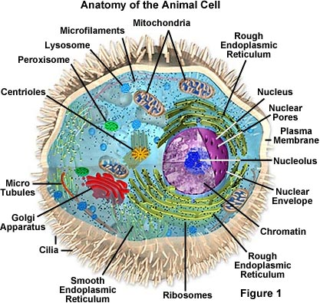
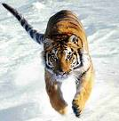
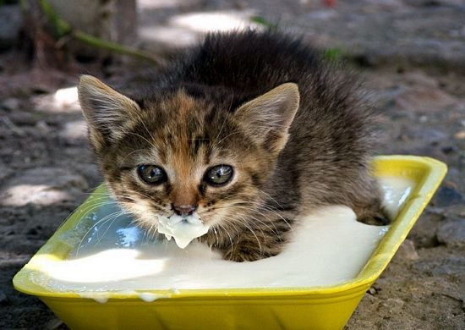
General Characteristics of Animals
Eukaryotic
Multicellular
Heterotrophic
NO cell walls!
Can move

Slide 3
Animal Behavior

Slide 4
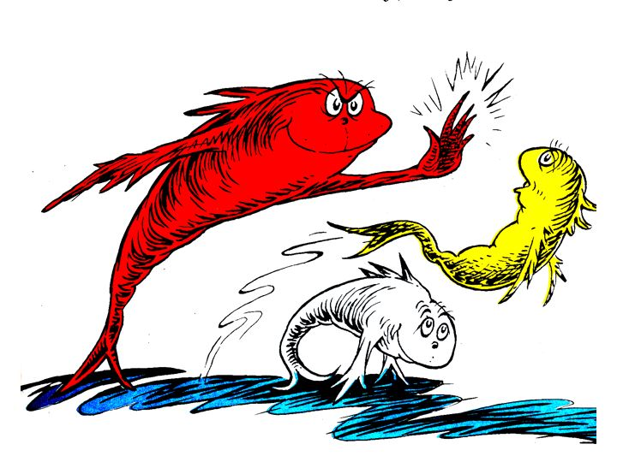
What is behavior?
Anything an animal does in response to a stimulus.
Behaviors are adaptations that help animals survive better.

Slide 5
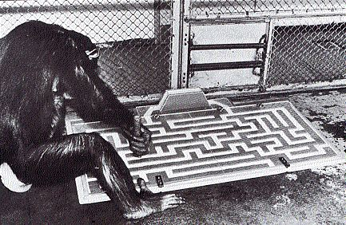
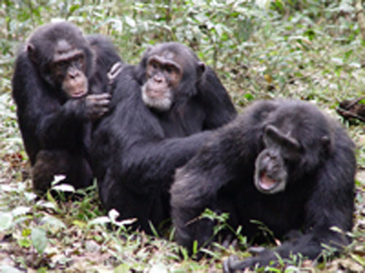
Types of Behavior
The three types of behavior are:
Innate behavior
Learned behavior
Social behavior

Slide 6
Innate Behavior
This is behavior you are born with.
You are not taught these behaviors.
Includes the following
Suckling
Taxis
Migration
Estivation
Hibernation

Slide 7
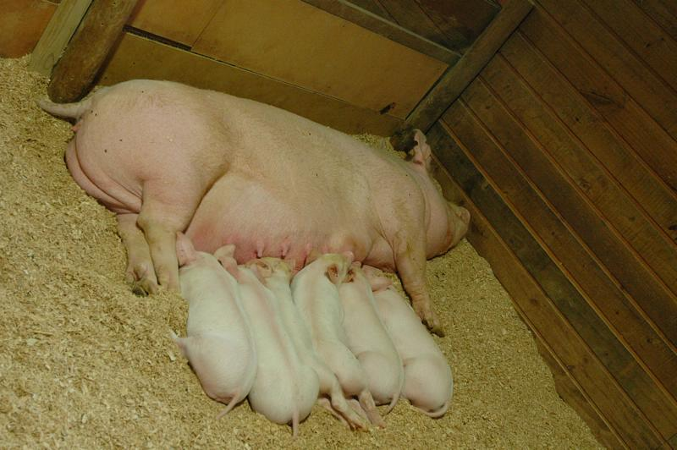
Suckling
An instinct babies are born with to get food

Slide 8
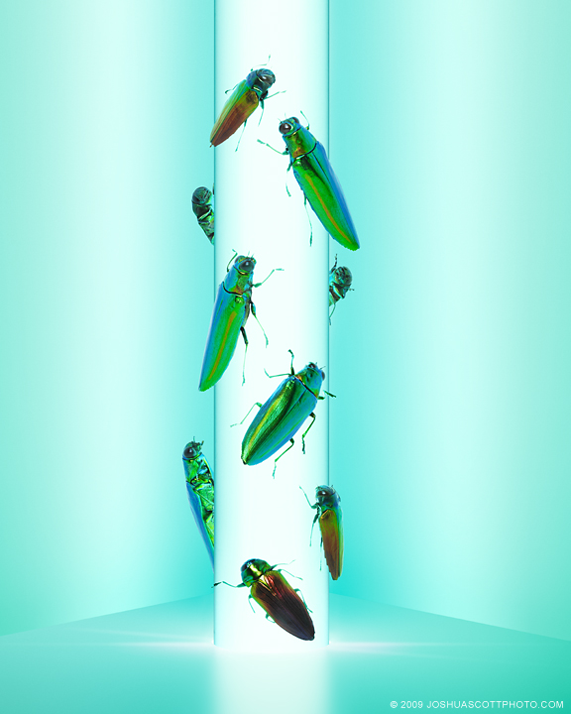
Taxis
Moving toward or away from a stimulus

Slide 9
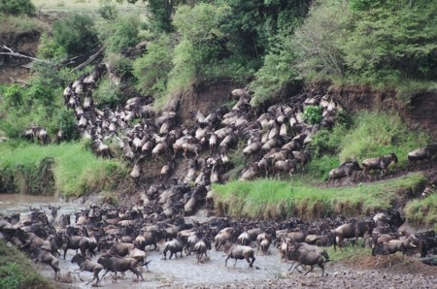
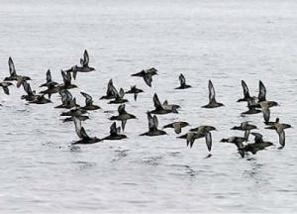
Migration
Seasonal movement of animals

Slide 10
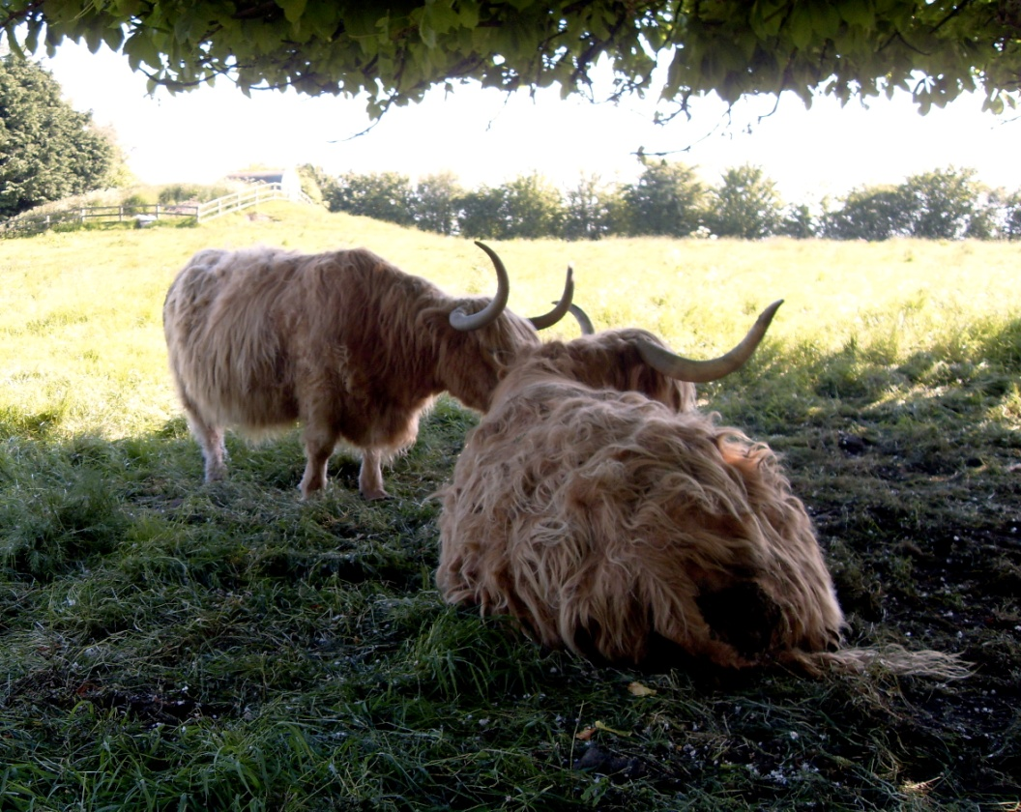
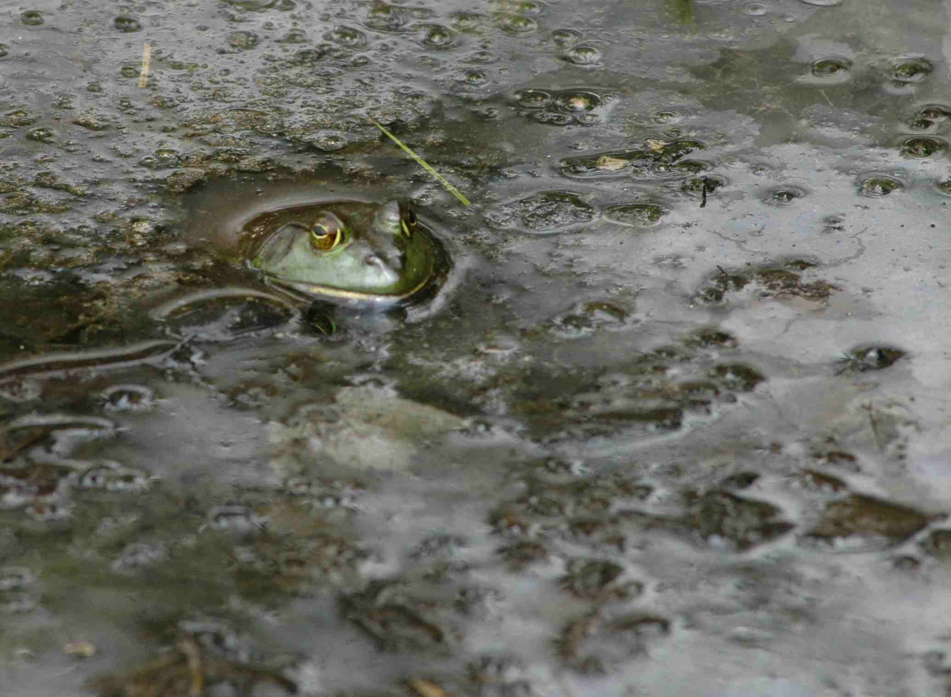
Estivation
A period of rest for animals during intense heat or drought.

Slide 11
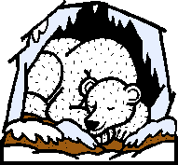
Hibernation
A deep sleep to conserve energy during periods of cold weather

Slide 12
Learned Behaviors
Learned behaviors are established through practice or experience.
Learned behaviors include:
Habituation
Imprinting
Classical Conditioning
Trial and Error

Slide 13
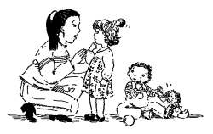
Habituation
When an animal is continually given a stimulus and eventually does not respond to it.

Slide 14
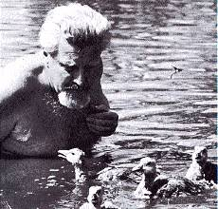
Imprinting
When an animal forms an attachment with another animal shortly after birth.

Slide 15
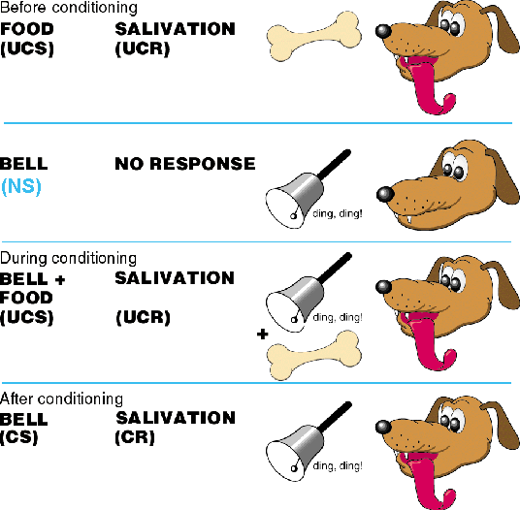
Classical Conditioning
Learning to relate two unrelated things

Slide 16
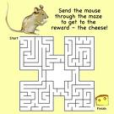
Trial and Error
When through practice, an animal receives a reward for a “correct” response.

Slide 17
Social Behavior
Social behavior taking place between members of the same species.
These include the following:
Phermones
Courtship Dances
Territorial Defense

Slide 18
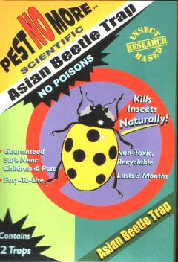
Phermones
Chemical signals that are given off by animals as a means of communication.

Slide 19
Courtship Dances
The behavior males and females carry out before mating.

Slide 20
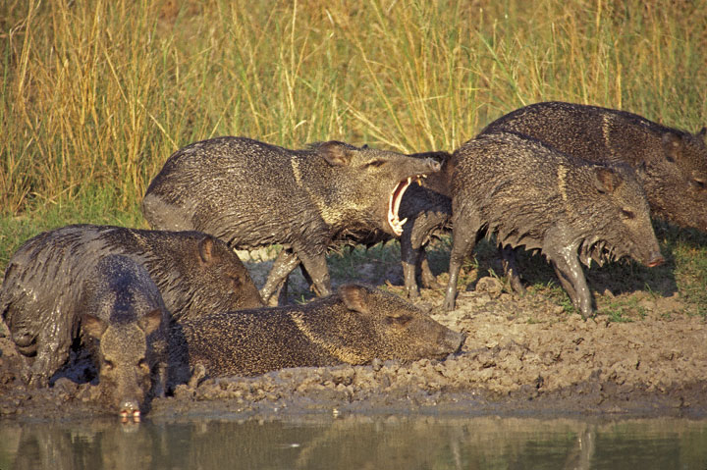
Territorial Defense
Defending an animals’ breeding area, feeding area or potential mates

Slide 21
Videos
Taxis
http://www.youtube.com/watch?v=RlycBtqIGUQ (plant phototaxis)
Migration
http://www.youtube.com/watch?v=LawHWsIqa5s (monarch butterfly)

Slide 22
Imprinting
http://www.youtube.com/watch?v=-PBYySnwHxc (Tom and Jerry)
http://www.youtube.com/watch?v=LGBqQyZid04 (puppy and duckling)
Classical Conditioning
http://www.youtube.com/watch?v=HfTTm-rgFFI (Attack of the Quack)
Trial and Error
http://www.youtube.com/watch?v=zeL_StmgSNE (bird and bank)
http://www.youtube.com/watch?v=PUCo8dkGksk (baby and peek a boo with door)
Phermones
http://www.youtube.com/watch?v=gcHt5n3NGK0 (ants)
Courtship Dances
http://www.youtube.com/watch?v=lMbDjNDD4cM (birds compilation)
Territorial Defense
http://www.youtube.com/watch?v=vM3ETU0K5P8 (rhinos)

