Slide 1
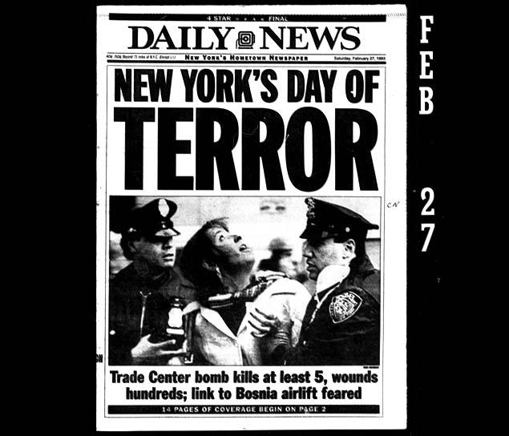
1993 World Trade Center Bombing
By Nick, Jon and Matt

Slide 2
Quick Facts
Killed 6 people
Injured more than 1,000
6 suspects convicted
Abdul Rahmen Yasis (terror suspect) is still at large.
The bomb was a 1,200 pound Ryder Truck

Slide 3
Class Discussion
What do you know about this bombing?
Why isn’t this attack as popular as 9/11?

Slide 4
Timeline
February 26, 1993-12:18 PM, a massive truck bomb ripped a hole across the B-2 level of the parking garage beneath the World Trade Center's North Tower. The blast wave was so powerful that it penetrated five stories of the reinforced concrete building.
1993, the FBI and its partners on the New York Joint Terrorism Task Force began staffing up a command center and preparing to send in a team to investigate.
February 28, 1993- The FBI confirmed that a bomb caused the explosion; discovered were pieces of a van with vehicle ID on them, An Islamic fundamentalist named Mohammad Salameh had rented the vehicle.

Slide 5
Timeline Ct.
March 4th, 1994- FBI followed lead after lead, which led to the connection of Nidal Ayyad, Mahmoud Abouhalima, and Ahmed Ajaj, in addition to Mohammad Salameh. These four men were tried, convicted and justifully sentenced to life in prison.
June 24, 1994, more leads also led to the FBI storming into a warehouse in Queens and detaining several members of a terrorist cell in the act of assembling bombs.
February 1995, after discovering the name of the mastermind, Ramzi Yousef, he was captured in pakistan. After interrogation, the FBI learned that he wanted the bomb to topple one tower, with the collapsing debris knocking down the second. The attack turned out to be something like practice for 9/11

Slide 6
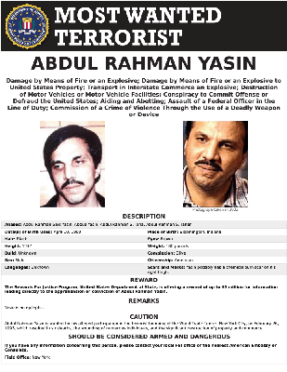
Names of Involved Terrorists
Ramzi Yousef
Mahmud Abouhalima
Mohammad Salameh
Nidal A. Ayyad
Abdul Rahman Yasin
Ahmed Ajaj

Slide 7
Research Questions
Q:What type of bomb was used?
A: A nitrate-hydrogen gas enhanced bomb also stuffed with cyanide that weighed 1,200 pounds.
Q: Why did they do it?
A: Ramzi Yousef, who directed the organization and execution of the bombing, said he did it to “avenge the sufferings Palestinian people had endured at the hands of US-aided Israel.”
nitrate-hydrogen gas enhanced bomb also stuffed with cyanide into the parking garage below the World Trade Center in Manhattan.

Slide 8
Research question 3
Q: How did this attack change the WTC’s security?
A: The security was amped up around the parking garages where the attack took place, however security did not have a huge change until September 11, 2001

Slide 9
Citations
Gearty, Robert. "Bomber’s plea: Man behind ’93 WTC attack wants prison rules eased ." NY Daily News. N.p., 23 Aug. 2012. Web. 16 Apr. 2017.
"ABDUL RAHMAN YASIN." FBI. FBI, 26 July 2010. Web. 16 Apr. 2017.
"1993 World Trade Center Bombing Fast Facts." CNN. Cable News Network, 21 Feb. 2017. Web. 16 Apr. 2017.
"World Trade Center Bombing 1993." FBI. FBI, 18 May 2016. Web. 19 Apr. 2017.
1993 World Trade Center Bombing." National September 11 Memorial & Museum. N.p., n.d. Web. 19 Apr. 2017.

