Slide 1
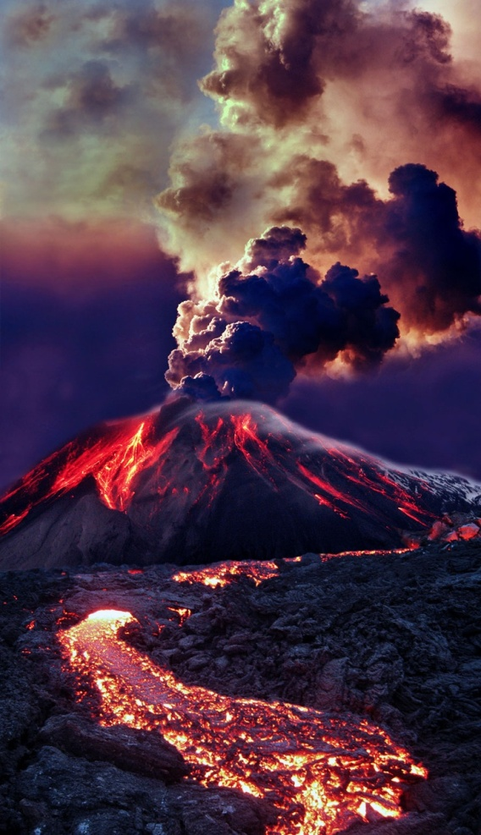
1.3: Types of Volcanoes
Describe basic shapes of volcanoes.
Compare the features of volcanoes.
Describe the stages in volcano formation.

Slide 2
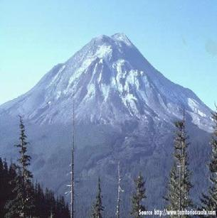
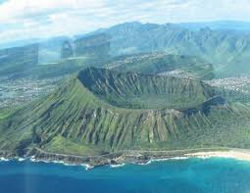
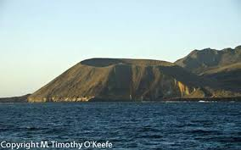
What are Volcanoes?
Volcanoes are vents through which molten rock and gas escape from a magma chamber.
Volcanoes can differ in:
Height
Shape
Slope steepness
Magma composition plays a big role in the shape a volcano forms.

Slide 3
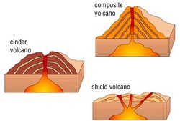
4 Main Types of Volcanoes
Composite Volcanoes
Shield Volcanoes
Cinder Cones
Supervolcanoes

Slide 4
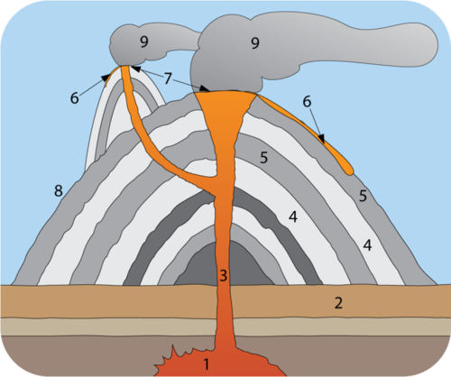
Composite Volcanoes
Are also called Stratovolcanoes
Form when high viscosity magma erupts explosively
Large, Symmetrical, Steep
Have alternating layers of ash and lava
Magma Chamber
Bedrock
Pipe
Ash Layers
Lava Layers
Lava Flow
Vent
Steep Side
Ash Cloud

Slide 5
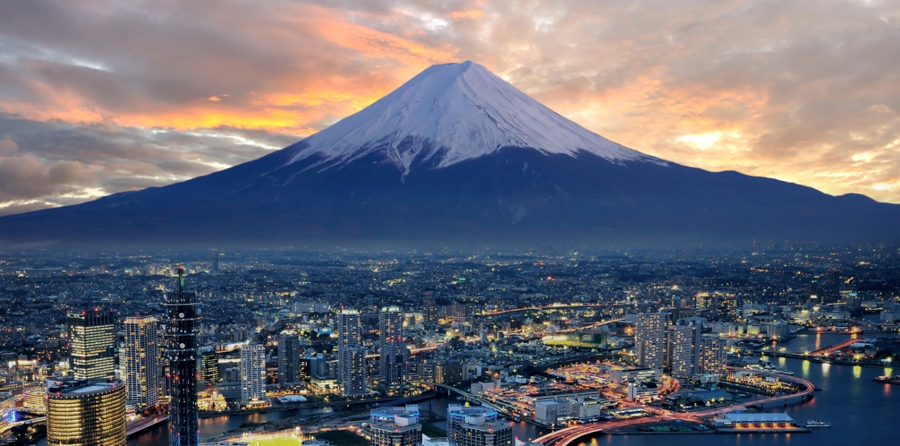
Composite Volcanoes
Mt. Fuji, the highest mountain in Japan, is a dormant composite volcano. City: Yokohama.

Slide 6
Composite Volcanoes
Mount St. Helens was a beautiful, classic, cone-shaped volcano.
The volcano’s 1980 eruption blew more than 400 meters (1,300 feet) off the top of the mountain.

Slide 7
Shield Volcanoes
Get their name from their shape
Are not steep but can be very broad
Are common at divergent boundaries and intraplate hotspots
Form from low viscosity magma that erupts effusively
Layers are usually similar in composition

Slide 8
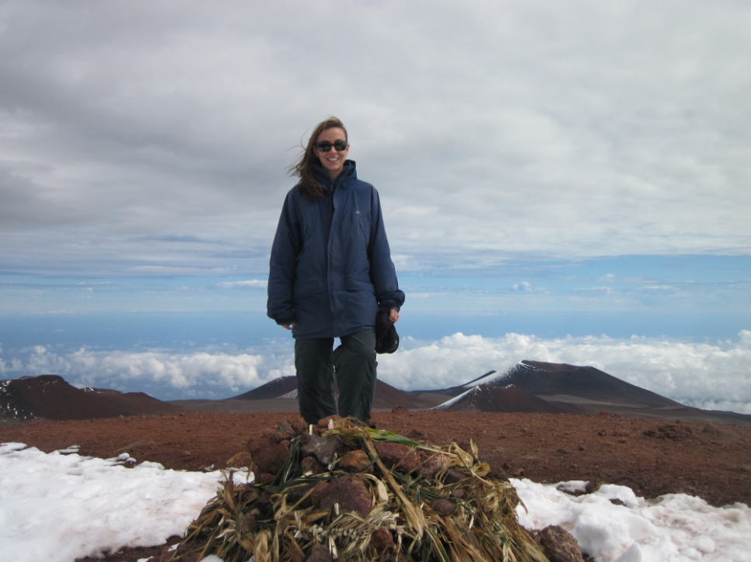
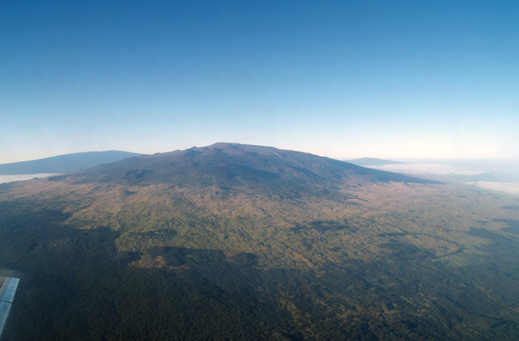
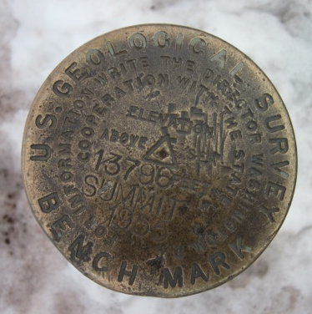
Shield Volcanoes
Elevation 13, 796 ft
Mauna Loa Volcano in Hawaii is the largest shield volcano on Earth with a diameter of more than 112 kilometers (70 miles). The volcano forms a significant part of the island of Hawaii.

Slide 9
Cinder Cone Volcanoes
Most common type of volcano
Steep sides
Shorter than composite volcanoes
Not as broad as shield volcanoes
Grow rapidly
Composed of small fragments of rock, like pumice, piled on top of one another
Usually have a crater at the summit
Often found near larger volcanoes

Slide 10
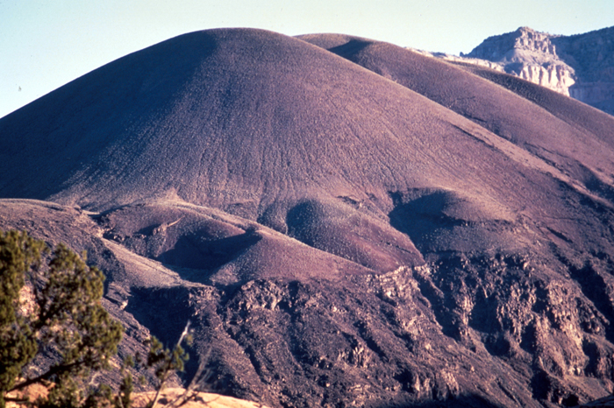
Cinder Cone Volcanoes
Vulcan’s Throne
North rim of the
Grand Canyon

Slide 11
Supervolcanoes
Most dangerous type of volcano
Unimaginably large (erupt 1000 km³ or 240 miles³ of materials)
Extremely rare
Entire magma chamber erupts at one time
Creates a huge caldera into which the surface collapses

Slide 12
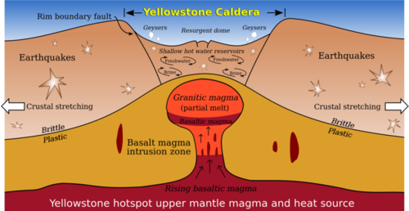
Supervolcanoes
Click on the image to go to National Geographic interactive “When Yellowstone Explodes” or go to
http://ngm.nationalgeographic.com/2009/08/yellowstone/yellowstone-interactive

Slide 13
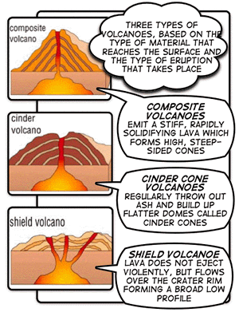
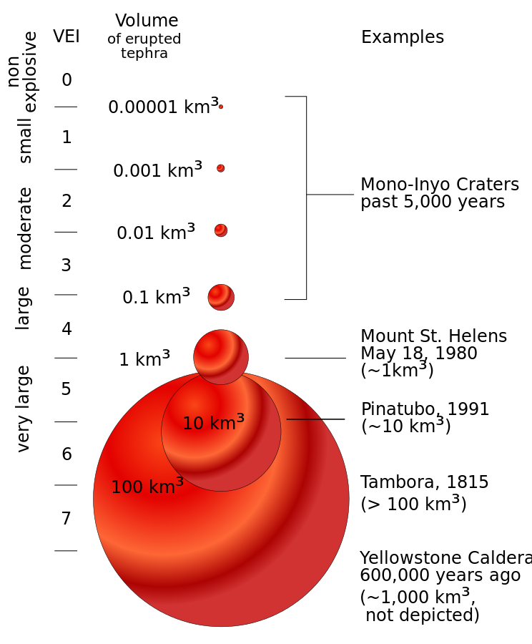
Review: Types of Volcanoes
Smithsonian / USGS Weekly Volcanic Activity Report

Slide 14
1.4: Volcanic Landforms and Geothermal Activity
List and describe landforms created by lava.
Explain how magma creates different landforms.
Describe the processes that create hot springs and geysers.

Slide 15
Volcanic Landforms
Landforms from Lava
Volcanoes and Vents
Lava Domes
Lava Plateaus
New Land
Landforms from Magma
Magma Intrusions (aka Igneous Intrusions)

Slide 16
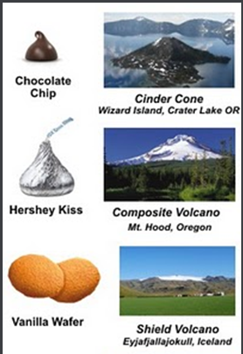
Volcanoes and Vents
Volcanoes

Slide 17
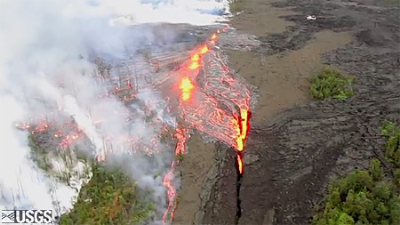
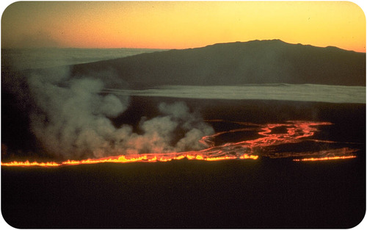
Volcanoes and Vents
Vents (Fissures)
Create ocean floor
Create new land
Watch Video at:
2011 Hawaiian Fissure
A fissure eruption on Mauna Loa in Hawaii travels toward Mauna Kea on the Big Island.

Slide 18
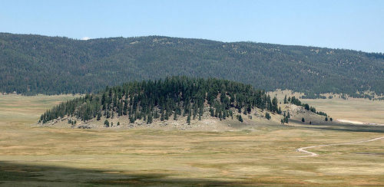
Lava Domes
Form when viscous lava erupts without exploding (not enough lava and/or pressure)
Lava domes are large, round landforms created by thick lava that does not travel far from the vent.

Slide 19
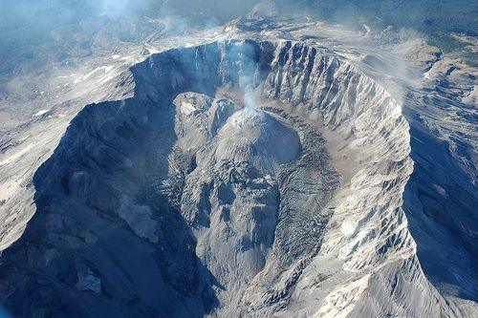
Lava Domes
Lava domes may form in the craters of composite volcanoes such as at Mount St. Helens.

Slide 20
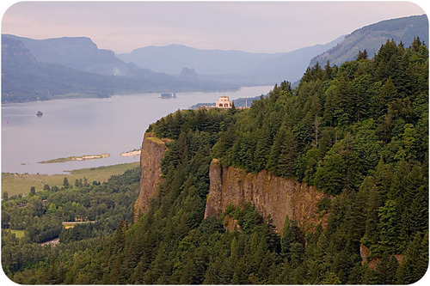
Lava Plateaus
Large, flat areas of igneous rock
Form when large amounts of fluid lava flows over an extensive area.
Layer upon layer of basalt have created the Columbia Plateau, which covers more than 161,000 square kilometers (63,000 square miles) in Washington, Oregon, and Idaho.

Slide 21
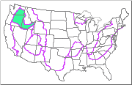
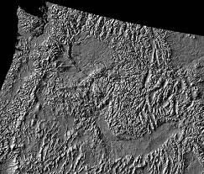
Lava Plateaus
Columbia Plateau

Slide 22
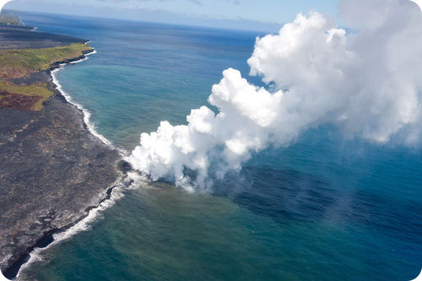
Land
Lava hitting seawater along coastlines creates new land.

Slide 23
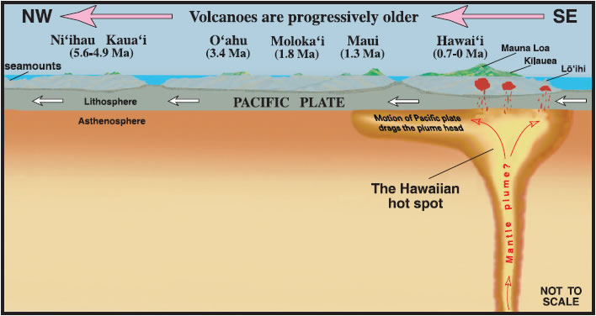
Land
Over time, volcanic eruptions can create islands as lava builds up layer by layer on the ocean floor.
The next Hawaiian island that will come into being - already named Loihi - is building on the seafloor southeast of Kilauea.
It’s top is 1000 m (3000 feet) below the water surface, and it will break the surface in the next 10,000 to 100,000 years.

Slide 24
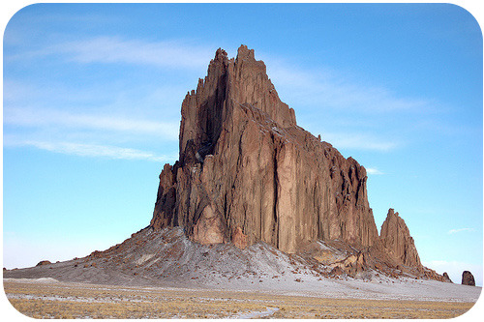
Magma Intrusions
Form when magma cools and solidifies before it reaches the surface.
Shiprock in New Mexico is the neck of an old volcano that has eroded away.

Slide 25
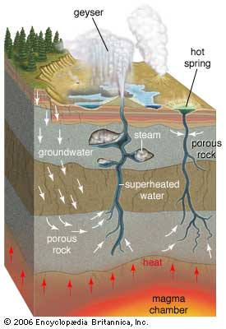
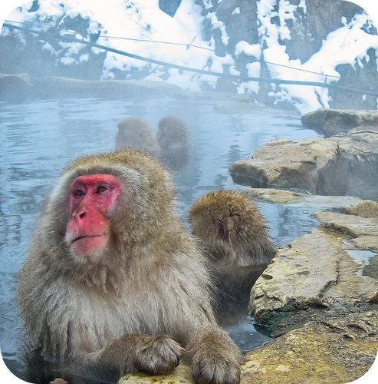
Geothermal Activity
Groundwater can be heated by magma near Earth’s surface.
Results in Hot Springs or Geysers

Slide 26
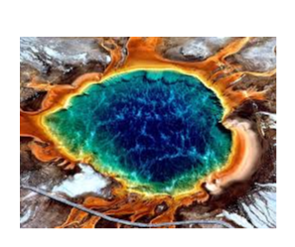
Hot Springs
Water heated below ground that rises through a crack to the surface creates a hot spring.
Yellowstone’s hot water systems often show distinct gradations of living, vibrant colors where the temperature limit of one group of microbes is reached, only to be replaced by a different set of thermophiles.

Slide 27
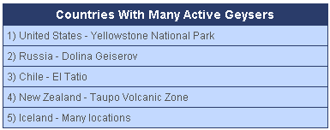
Geysers
A geyser is a vent in Earth's surface that periodically ejects a column of hot water and steam.

Slide 28
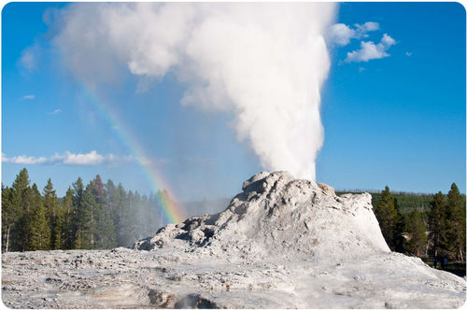
Geysers
Castle Geyser is one of the many geysers at Yellowstone National Park. Castle erupts regularly, but not as frequently or predictably as Old Faithful.

Slide 29
