Slide 1
Air Movement
List the properties of the air currents within a convection cell.
Describe how high and low pressure cells create local winds and explain how several types of local winds form.
Discuss how global convection cells lead to the global wind belts.

Slide 2
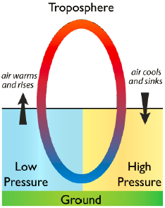
Why Air Moves
Within the troposphere are convection cells.
Warm air rises, creating a low pressure zone.
Cool air sinks, creating a high pressure zone.
Air that moves horizontally between high and low pressure zones makes wind.
The greater the pressure difference between the pressure zones the faster the wind moves.

Slide 3
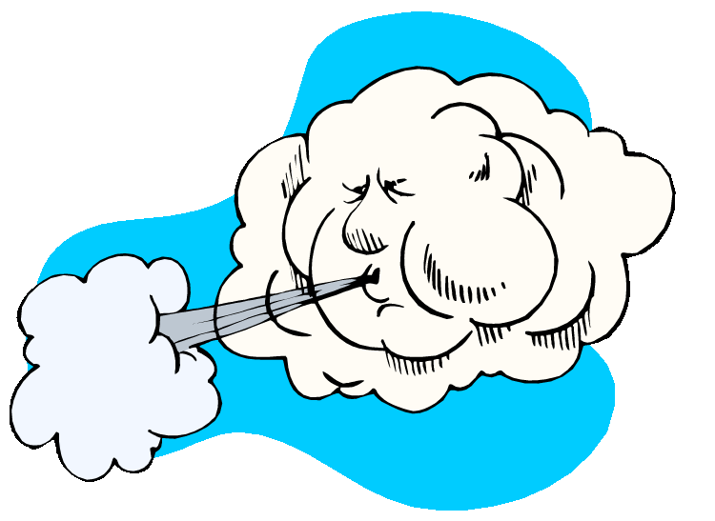
Local Winds
Result from air moving between small low and high pressure systems
Include:
Land and Sea Breezes
Monsoon Winds
Mountain and Valley Breezes
Katabatic Winds
Chinook Winds (Foehn Winds)
Santa Ana Winds
Desert Winds

Slide 4
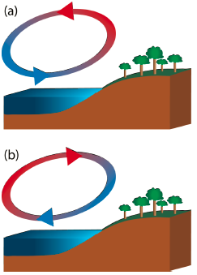
Land and Sea Breezes
If there is a large temperature difference between the surface of the sea (or a large lake) and the land next to it, high and low pressure regions form.
Sea breezes blow from the cooler ocean over the warmer land in summer.
Land breezes blow from the land to the sea in winter.

Slide 5
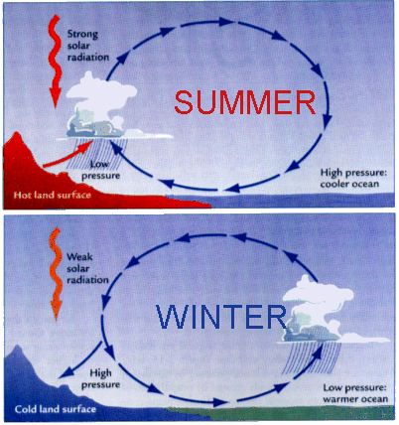
Monsoon Winds
are larger scale versions of land and sea breezes
blow from sea onto land in summer
blow from land onto sea in winter
occur where very hot summer lands are next to the sea
Thunderstorms are common during monsoons.

Slide 6
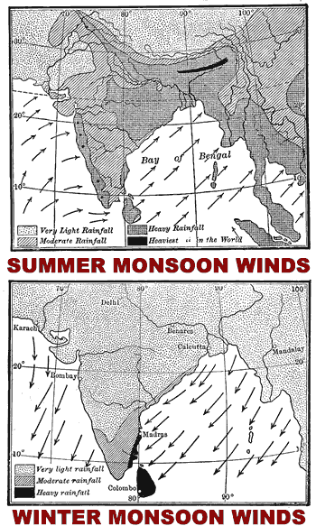
Monsoon Winds
The most important monsoon in the world occurs each year over the Indian subcontinent.
More than two billion residents of India and southeastern Asia depend on monsoon rains for their drinking and irrigation water.
Back in the days of sailing ships, seasonal shifts in the monsoon winds carried goods back and forth between India and Africa.

Slide 7
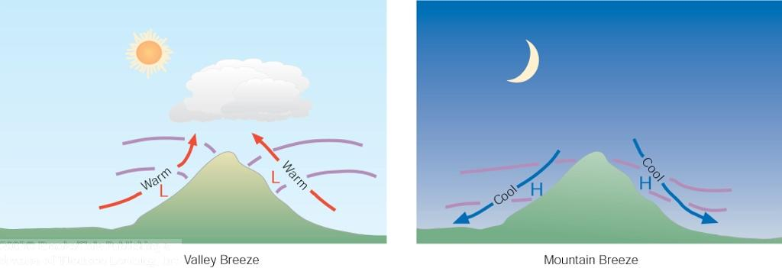
Mountain and Valley Breezes
Created by temperature differences between mountains and valleys
During the day, air on mountain slopes is heated more than air at the same elevation over an adjacent valley.
As the day progresses, warm air rises and draws the cool air up from the valley, creating a valley breeze.
At night the mountain slopes cool more quickly than the nearby valley, which causes a mountain breeze to flow downhill.

Slide 8
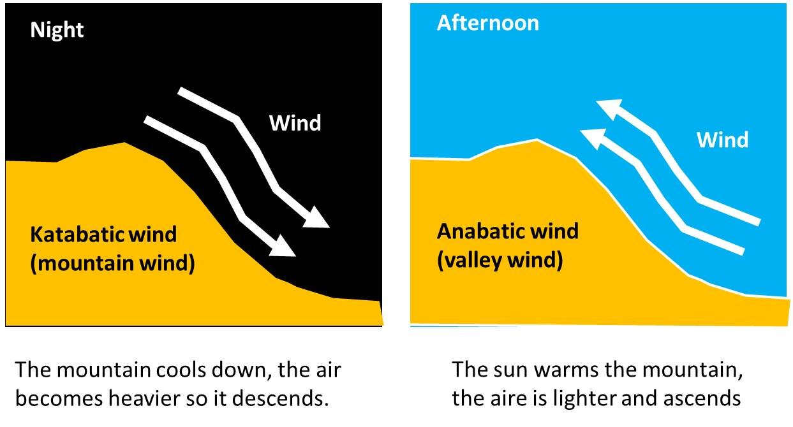
Katabatic and Anabatic Winds
Are stronger versions of mountain and valley breezes that take place at high elevations
Wind speeds depend on differences in air pressure.

Slide 9
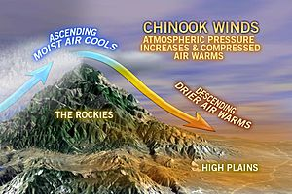
Chinook Winds
develop when air is forced up over a mountain range
Windward Side
side that receives the wind
Leeward Side
side where air sinks
Rainshadow Effect
rainshadow = leeward side
drier side of the mountain
can create deserts

Slide 10
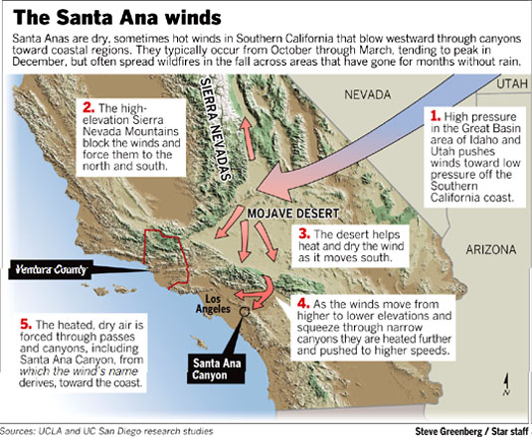
Santa Ana Winds

Slide 11
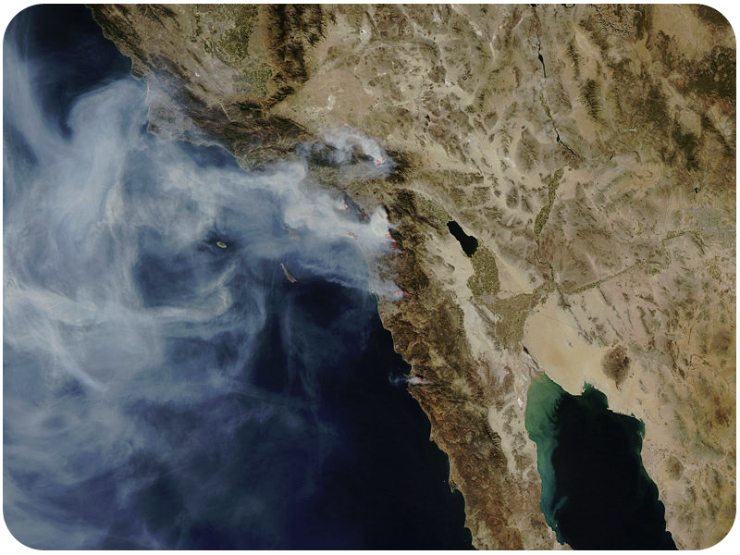
Santa Ana Winds
Santa Ana winds blow dust and smoke westward over the Pacific from Southern California.

Slide 12
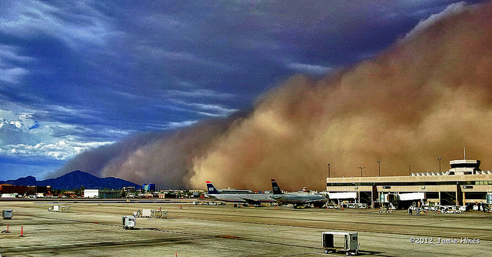
Desert Winds
Desert winds pick up dust because there is not as much vegetation to hold down the dirt and sand.
Haboob Dust Storm
forms in the downdrafts on the front of a thunderstorm.

Slide 13
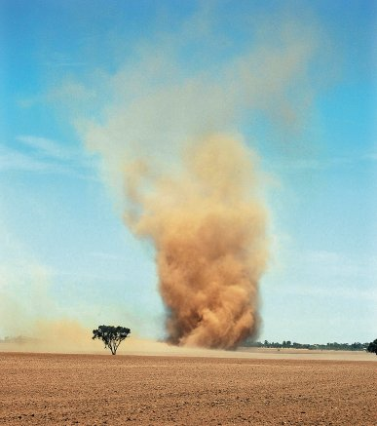
Desert Winds
Dust Devils/Whirlwinds
form as the ground becomes so hot that the air above it heats and rises
Air flows into the low pressure zone and begins to spin.

Slide 14
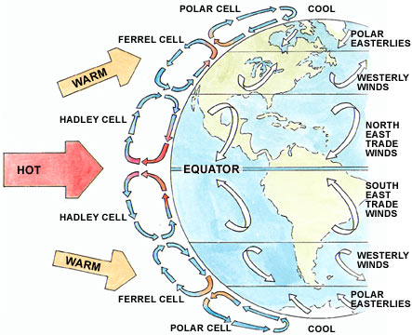
Atmospheric Circulation
Because more solar energy hits the equator, the air warms and forms a low pressure zone.
At the top of the troposphere, half moves toward the North Pole and half toward the South Pole.
The Coriolis Effect bends convection cells north and south of the equator to create Global Wind Belts.
Wind belts are named for the directions from which the winds come.

Slide 15
Global Winds and Precipitation
The high and low pressure areas created by the six atmospheric circulation cells determine in a general way the amount of precipitation a region receives.
In low pressure regions, where air is rising, rain is common.
In high pressure areas, the sinking air causes evaporation and the region is usually dry.

Slide 16
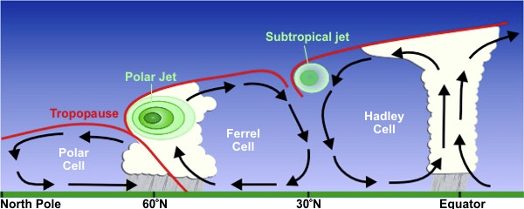
Polar Fronts and Jet Streams
Polar Front
junction between the Ferrell and Polar cells
relatively warm, moist air of the Ferrell Cell runs into relatively cold, dry air of the Polar cell
Weather is extremely variable
Jet Stream
found high up in the atmosphere where the two cells come together
Fast flowing river of air at the tropopause
forms where there is a large temperature difference between two air masses

